Slide 1




COVID-19
Economic Relief Package
SMALL BUSINESS EMERGENCY
ASSISTANCE GRANT PROGRAM – PHASE 4
April 20, 2021
1

Slide 2


Overall COVID-19 Relief Programs Statistics*
Awards Approved
55,500+
Support Provided
$257 Million
* 3/24
2

Slide 3





COVID-19 Economic Relief Package
Small Business Emergency Assistance Grant Program
43,777 applications approved for $213.6 million in grants
Small Business Emergency Assistance Loan Program
151 applications approved for nearly $10.4 million in loans
Sustain and Serve NJ
$14 million to support purchases of 1.5 million meals
Small and Micro Business PPE Access Program
11,190 businesses approved for more than $9.5 million in discounts
Programs to Mobilize Capital to Micro, Small, & Medium Sized Businesses (CDFIs)
291 applications approved for $7.3 million in loans
Entrepreneur Support Program
13 companies – 47 Investors approved for guarantees totaling $2 million supporting
investment totaling $2.5 million
Technical Assistance – SBA,E-Commerce, Business Consulting
538 applications assisted with services totaling $537,668
3

Slide 4
SMALL BUSINESS EMERGENCY ASSISTANCE GRANT PROGRAM – PHASE 4
Targeted funding
for restaurants, child care, small and micro businesses
Program Size
$85M 33% set aside for businesses in OZ-eligible census tracts
Eligibility (up to 50 FTEs)
Award sizes (up to
$20,000)
All applicants must pre-register online between April 19 – April 29
FUNDING ALLOCATED IN “BUCKETS” BASED ON NEED
Restaurants
(Up to 50 FTEs)
Child Care
Micro Business
(1-5 FTEs)
All Other Businesses
(6-50 FTEs)
$35M
$10M
$25M
$15M
4
Businesses Not Approved for Phase 3 Support Are Eligible for Early Application

Slide 5
PHASE 4 PROGRAM TIMELINE
Don’t Forget!!!*
► Businesses must pre-register online between April 19 and April 29 to be eligible to apply
► Pre-registered businesses must return to https://business.nj.gov/covid to complete and submit an application based on the schedule below
► Businesses that did not apply in Phase 3, or applied and were not approved for Phase 3 funding, are eligible to apply first (May 3)
Applications will open on a rolling basis according to type of business.
5/3/2021
9:00 a.m.
5/5/2021
9:00 a.m.
5/10/2021
9:00 a.m.
5/12/2021
9:00 a.m.
Application opens
(Non-Phase 3)
Application opens
(Restaurants, Child Care)
Application opens (Micro)
Application opens (6-50 employees)
Applications will be open for one week per category.
* Must have been in existence and operational by February 15, 2020 to be eligible
5

Slide 6
APPLICATION SCHEDULE
Were you approved during Phase 3?
NO
YES
Apply on 5/3 at 9am EST
Is your business a restaurant or child care provider?
NO
YES
Does you business have 5 or fewer FTEs?
Apply on 5/5 at 9am EST
YES
NO
5 or fewer employees
Between 6-50 employees
Apply on 5/10 at 9am EST
Apply on 5/12 at 9am EST
6

Slide 7
SMALL BUSINESS EMERGENCY ASSISTANCE GRANT PROGRAM – PHASE 4 (RESTAURANTS)
Program Size
$35M 33% set aside for businesses in OZ-eligible census tracts
Operating expense grants of up to $20K to restaurants with 50 or fewer FTEs impacted by COVID-19
BBuussiinneessss EElliiggiibbiilliittyy
► Classified as “Food Services or Drinking Places”
Grant Awards
# of FTEs | Grant Award
5 or fewer | $10,000
6-25 | $15,000
26-50 | $20,000
NAICS Code 722
► Must have physical location in NJ
► Must be registered to do business in New Jersey
► Must be in Department of Labor good standing
Application Schedule
All applicants must pre-register online between Monday, April
19 and Thursday, April 29.
► Must fill out and certify debarment legal questionnaire
► Must certify to negative impact of emergency
► Must certify intent to not lay off any workers
Applications will open for restaurants on Wednesday, May 5, at 9:00 a.m. Applications will be processed on a first-come, first-served basis and will close on May 12, at 5:00 p.m.
7

Slide 8
SMALL BUSINESS EMERGENCY ASSISTANCE
GRANT PROGRAM – PHASE 4 (CHILD CARE PROVIDERS)
Program Size
$10M 33% set aside for businesses in OZ-eligible census tracts
Operating expense grants of up to $20k to child care businesses with 50 or fewer FTEs impacted by COVID-19
Business Eligibility
► Classified as “Child Care Providers”
Grant Awards
# of FTEs | Grant Award
5 or fewer | $10,000
6-25 | $15,000
26-50 | $20,000
NAICS Code 624410
► Must have physical location in NJ
► Must be registered to do business in New Jersey
► Must be in Department of Labor good standing
► Must fill out and certify debarment legal
questionnaire
► Must certify to negative impact of emergency
► Must certify intent to not lay off any workers
Application Schedule
All applicants must pre-register online between Monday, April 19 and Thursday, April 29.
Applications will open for child care providers on Wednesday, May 5, at 9:00 a.m. Applications will be processed on a first-come, first-served basis and will close on
May 12 at 5:00 p.m.
8

Slide 9
SMALL BUSINESS EMERGENCY ASSISTANCE GRANT PROGRAM – PHASE 4 (MICRO BUSINESSES)
Program Size
$25M 33% set aside for businesses in OZ-eligible census tracts
Operating expense grants of up to $10K to micro businesses with 5 or fewer FTEs impacted by COVID-19
Business Eligibility
► Must have physical location in NJ
► Must be registered to do business in New Jersey
► Must be in Department of Labor good standing
► Must fill out and certify debarment legal questionnaire
► Must certify to negative impact of emergency
► Must certify intent to not lay off any workers
Grant Awards
Micro businesses with five or fewer employees are eligible for a maximum grant of $10,000.
Application Schedule
All applicants must pre-register online between Monday, April 19 and Thursday, April 29.
Applications will open for micro businesses on Monday, May 10 at 9:00 a.m. Applications will be processed on a first-come, first-served basis and will close on May 17 at 5:00 p.m.
9

Slide 10
SMALL BUSINESS EMERGENCY ASSISTANCE GRANT PROGRAM – PHASE 4 (OTHER SMALL BUSINESSES)
Program Size
$15M 33% set aside for businesses in OZ-eligible census tracts
Operating expense grants of up to $20K to businesses
with between 6 and 50 FTEs impacted by COVID-19
Business Eligibility
► Most businesses and nonprofits are eligible
► Must have physical location in NJ
► Must be registered to do business in New Jersey
► Must be in Department of Labor good standing
► Must fill out and certify debarment legal questionnaire
► Must certify to negative impact of emergency
► Must certify intent to not lay off any workers
Grant Awards (All Businesses)
# of FTEs | Grant Award
6-25 | $15,000
26-50 | $20,000
Application Schedule
All applicants must pre-register online between Monday,
April 19 and April 29.
Applications will open on Wednesday, May 12, 9:00 a.m. for businesses with 6-50 employees that are not restaurants or child care providers and will be processed on a first-come, first-served basis and will close on May 19 at 5:00 p.m.
10

Slide 11
PHASE 4
REQUIRED INFORMATION
Be Prepared:
► View the sample application on https://business.nj.gov/covid
► Have your contact information and primary business address readily available
►If you have received other Government assistance (NJEDA, PPP, EIDL, EIDG, County or municipal funding, insurance, etc.), be prepared to provide information regarding status, uses and amounts.
Know Your:
►Business’s full legal name - the one used when your registered with the State of NJ
► Entity type (Sole Prop, LLC, C-Corp, S-Corp, etc.)
► Year established
► Tax ID Number
►Peak FTE count from a business’s past eight quarters of WR-30 filings
►North American Industry Classification System (NAICS Code)
► 2019/2020 Annual Revenue, Revenue lost due to COVID-19
Pre-registration opens on Monday, April 19, 2021 at 9:00 a.m.

Slide 12
BUSINESS REGISTRATION REQUIREMENT
Satisfaction of Business Registration Requirement
► A business must be registered to do business in the State of New Jersey, as evidenced by current registration status from the NJ Division of Taxation.
► If business is not recognized by the Division of Taxation, must provide a valid Business Registration Certificate (BRC). Applicant will have 4 weeks from initial notification from the NJEDA to satisfy that requirement.
► No grant agreement will be executed without a “current” registration status from the NJ Division of
Taxation or a valid Business Registration Certificate.
12

Slide 13
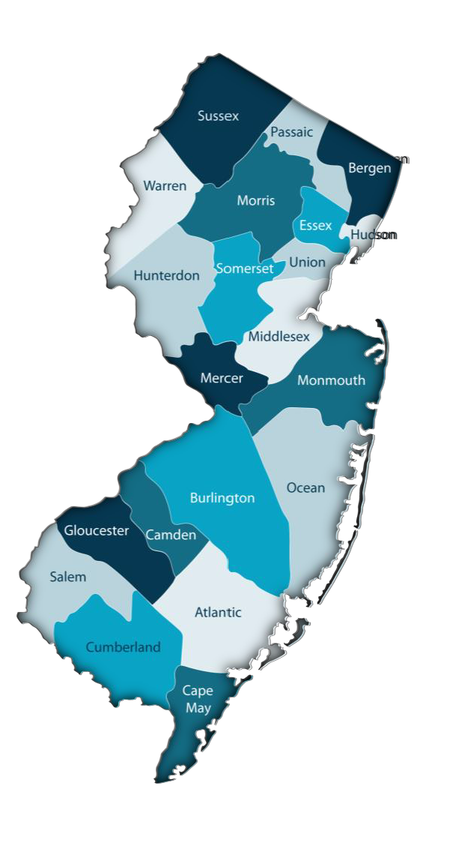
ENSURING EQUITY, INCREASING ACCESSIBLITY
33 percent of Phase 4 funding is reserved for eligible businesses in
Eligible Opportunity Zones Census Tracts (OZs)
Every county has at least one eligible Opportunity Zone census tract Link to COVID business portal for OZ map tool
Language access services are available to non-English speaking
applicants:
► Application and website (https://business.nj.gov/covid) available in Spanish
► NJEDA contracted for interpretation services to support speakers of ten additional languages – Arabic, Chinese (Mandarin and Cantonese), Gujarati, Hindi, Italian, Korean, Polish, Portuguese, and Tagalog. Translated versions of the application itself were available in advance of opening.
In advance of the application launch, applicants can contact languagehelp@njeda.com to receive a call within one business day from a representative who can communicate with them in their primary language
13

Slide 14





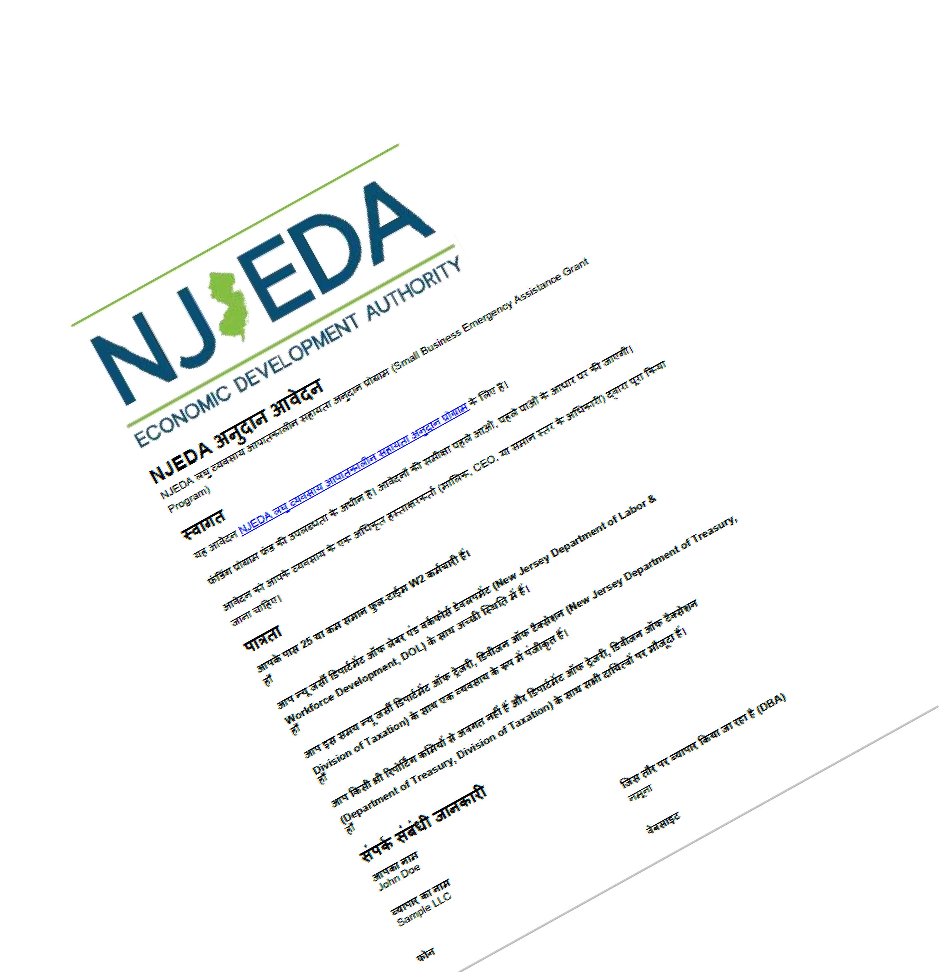
ENSURING EQUITY, INCREASING ACCESSIBLITY
14

Slide 15
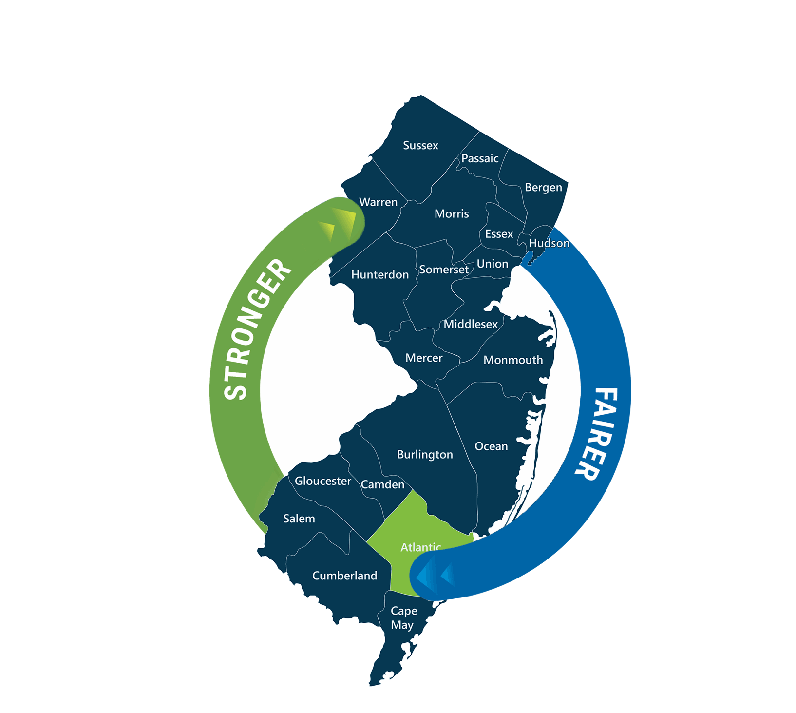
Small Business Emergency
Assistance Grant
Phase 4
Sample
Pre-Registration

Slide 16
Phase 4 Grant Pre-Registration
Small Business Emergency Assistance Grant
Interested business owners will need to pre-register in order to apply.
Pre-registration will be open from
Monday, April 19th at 9:00 a.m. and will close Thursday, April 29th at 5:00 p.m.
Pre-registered applicants will need to return to the portal to complete an application based on the following schedule:
Businesses that did not apply in Phase 3, or applied and were not approved for Phase 3 funding – 9:00 a.m. on Monday, May 3
Restaurants: Food Services and Drinking Places: NAICS Code must start with 722 – 9:00 a.m. on Wednesday, May 5, 2021
Child Care Providers: NAICS Code 624410 – 9:00 a.m. on Wednesday, May 5, 2021
Micro Businesses: 5 or less Full-Time Equivalent W2 employees or any entity that does not file a NJ-WR30 – 9:00 a.m. on Monday, May 10, 2021
Small Business: More than 5 Full-Time Equivalent W2 employees (excluding restaurants) – 9:00 a.m. on Wednesday, May 12, 2021
Application will be available at https://business.nj.gov/covid

Slide 17
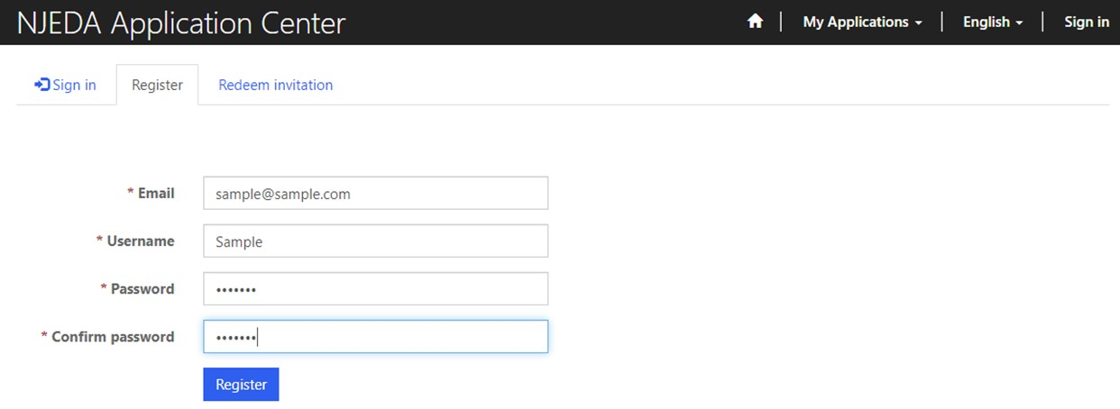
Phase 4 Grant Pre-Registration
Small Business Emergency Assistance Grant
How to Register Your Email Address for the Phase 4 Grant Program
Enter your email, username (can be the same as your email) and password.
Passwords must contain 1 upper case letter, 1 lower case letter and be at least 8 characters
Once information is filled in click “Register”
PLEASE MAKE SURE TO WRITE-DOWN YOUR USERNAME AND PASSWORD

Slide 18
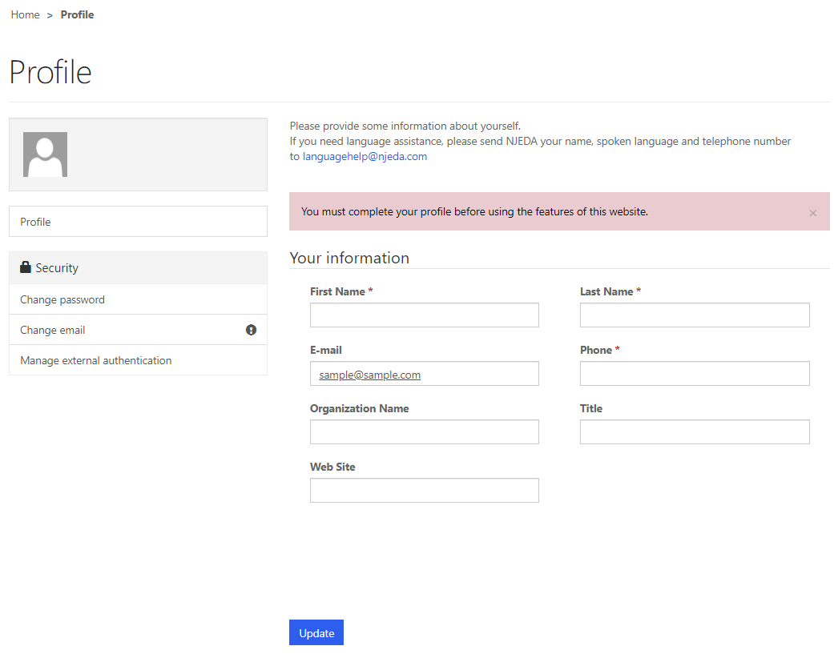
Phase 4 Grant Pre-Registration
Setting up your Profile
Small Business Emergency Assistance Grant
Once you click Register, you must enter
“Your Information”
First Name, Last Name and Phone Number is Required
Confirm your email address is correct (this will be the primary way the NJEDA contacts your business)
Once complete, click “Update”

Slide 19
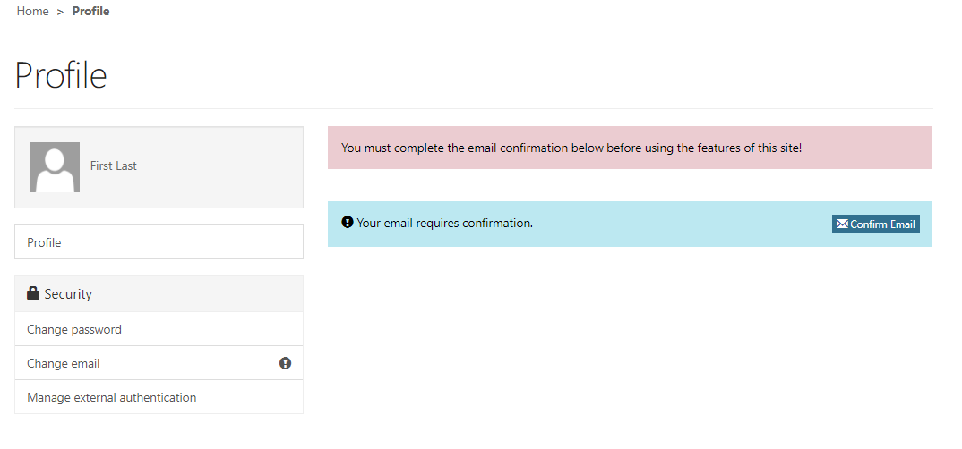
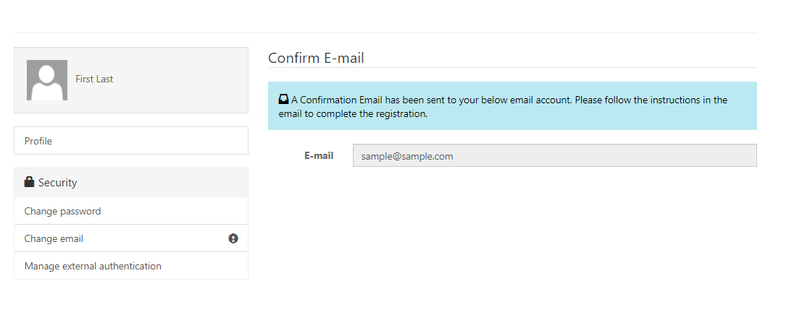
Phase 4 Grant Pre-Registration
Confirming Your Email
Small Business Emergency Assistance Grant
Once “Your Information” is complete, you will
need to confirm your email.
Within the blue box, click on “Confirm Email”
An email will be sent to the email address listed.
Go to your email and follow the instructions within the email.
You MUST confirm your email address, in order
to begin the Pre-Registration.
Once your email is Confirmed you MUST come back into the NJEDA Application Center to begin the Small Business Emergency Grant Phase 3 pre-Registration.

Slide 20
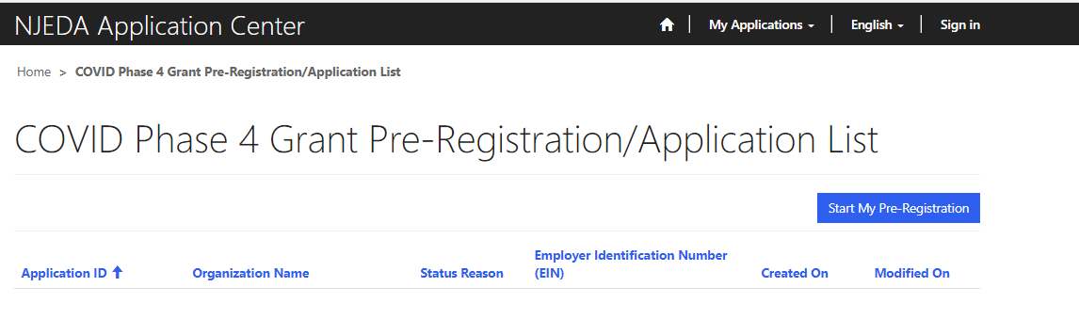
Phase 4 Grant Pre-Registration
Small Business Emergency Assistance Grant
Click Here

Slide 21
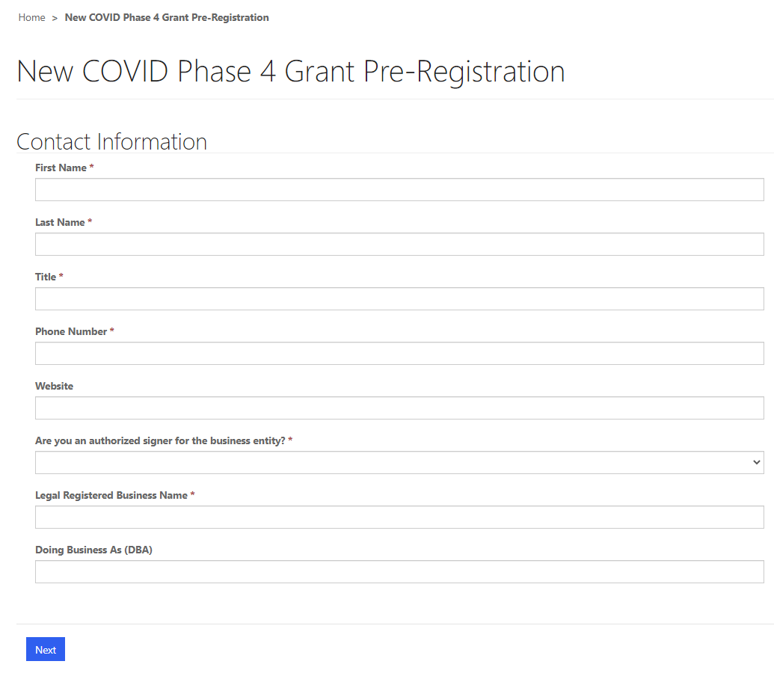
Phase 4 Grant Pre-Registration
Small Business Emergency Assistance Grant

Slide 22
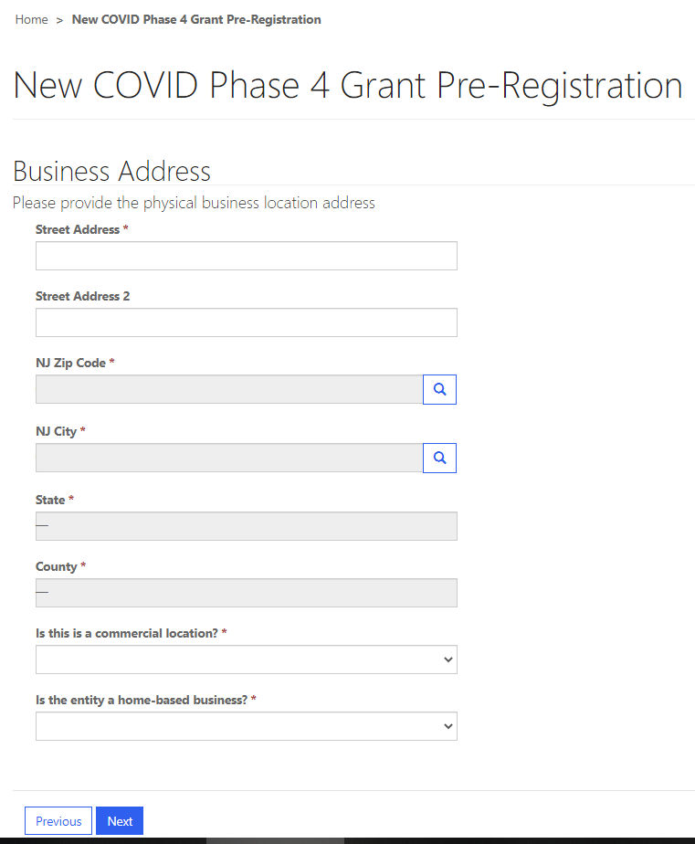
Phase 4 Grant Pre-Registration
Small Business Emergency Assistance Grant

Slide 23
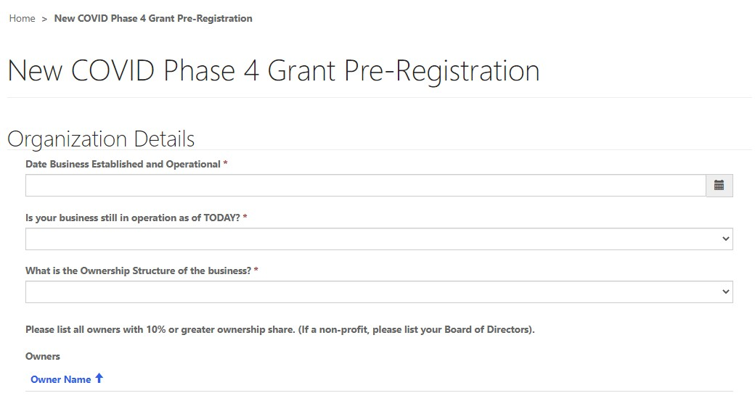
Phase 4 Grant Pre-Registration
Small Business Emergency Assistance Grant

Slide 24
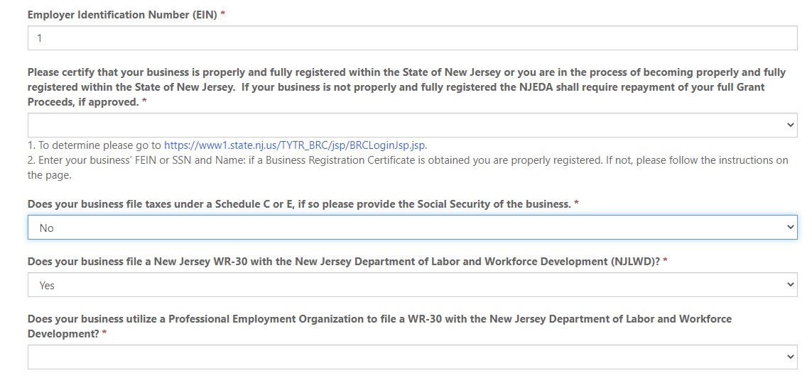
Small Business Emergency Assistance Grant
Phase 4 Grant Pre-Registration
Organization Details Continued…….

Slide 25
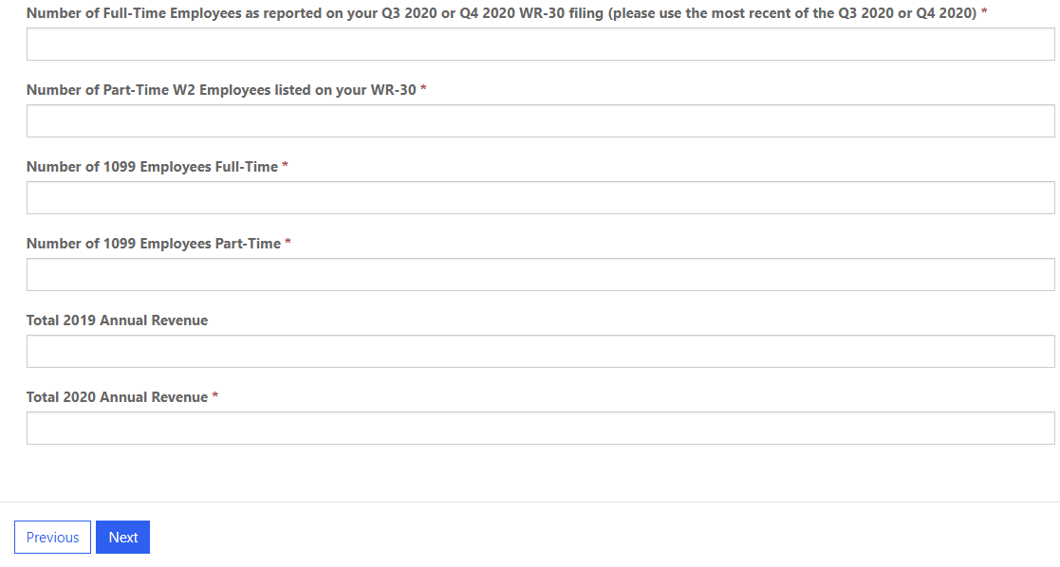
Small Business Emergency Assistance Grant
Phase 4 Grant Pre-Registration
Organization Details Continued…….

Slide 26
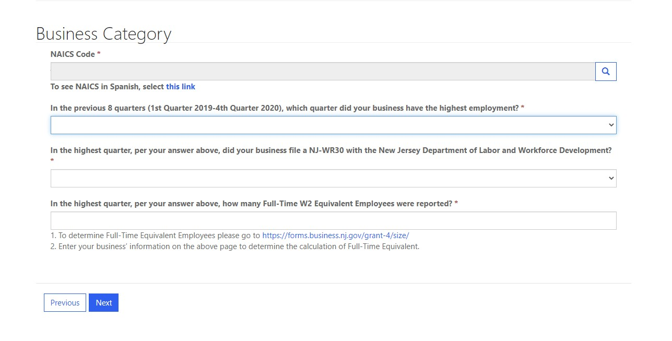
Phase 4 Grant Pre-Registration
Small Business Emergency Assistance Grant

Slide 27
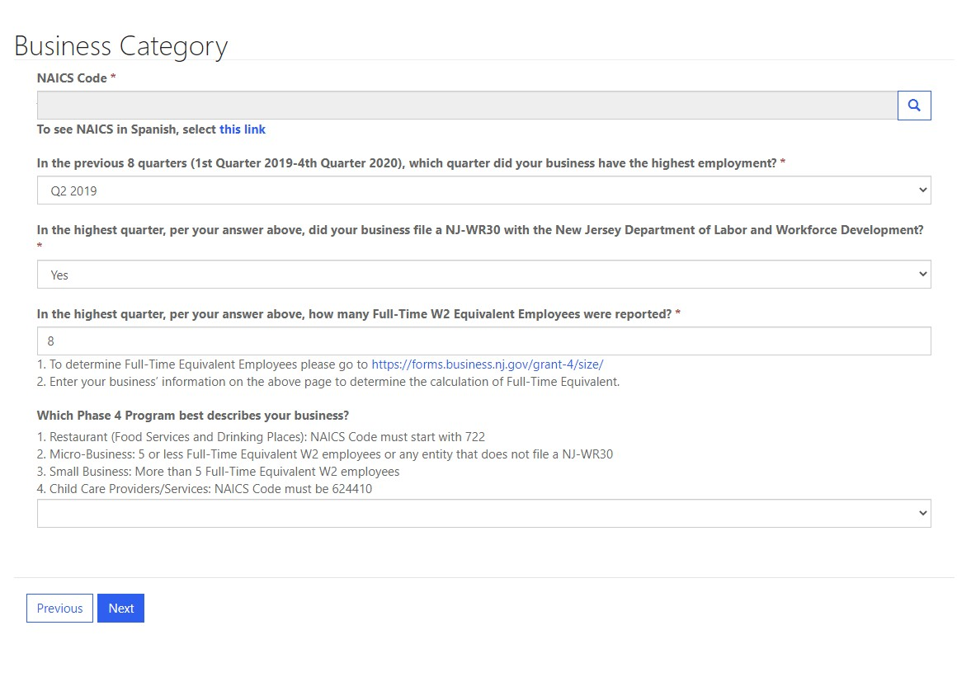
Phase 4 Grant Pre-Registration
Small Business Emergency Assistance Grant

Slide 28
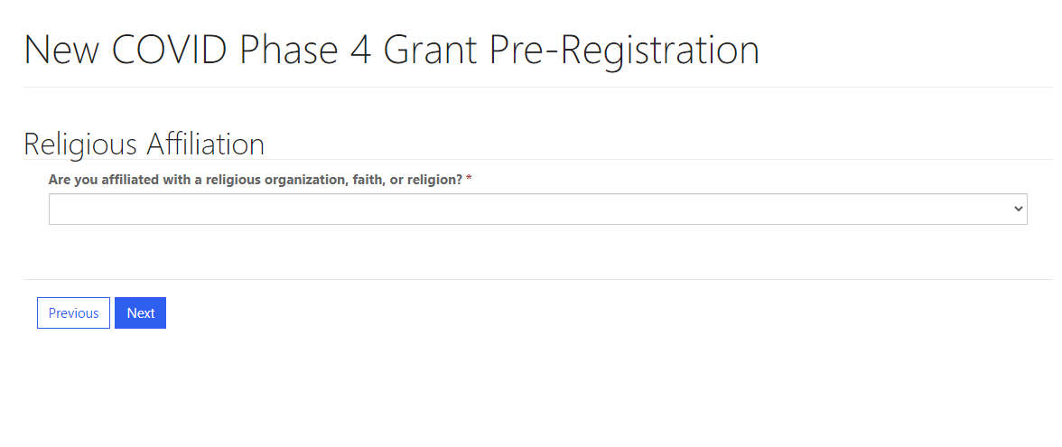
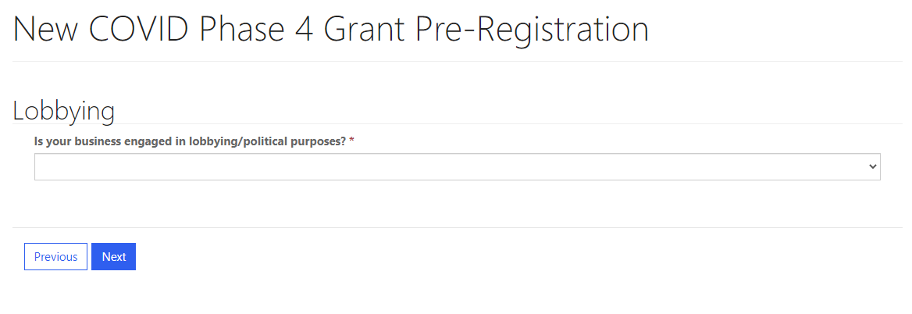
Phase 4 Grant Pre-Registration
Small Business Emergency Assistance Grant

Slide 29
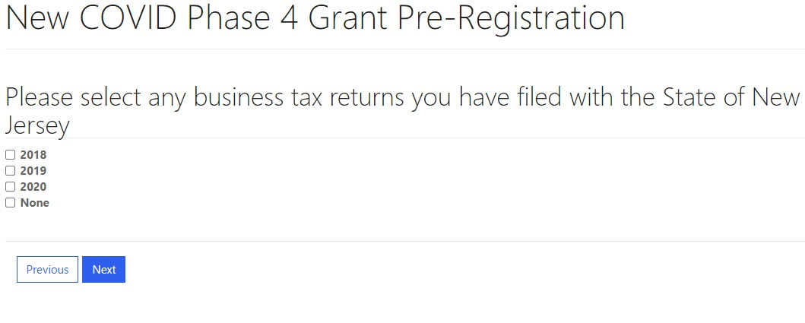
Phase 4 Grant Pre-Registration
Small Business Emergency Assistance Grant

Slide 30
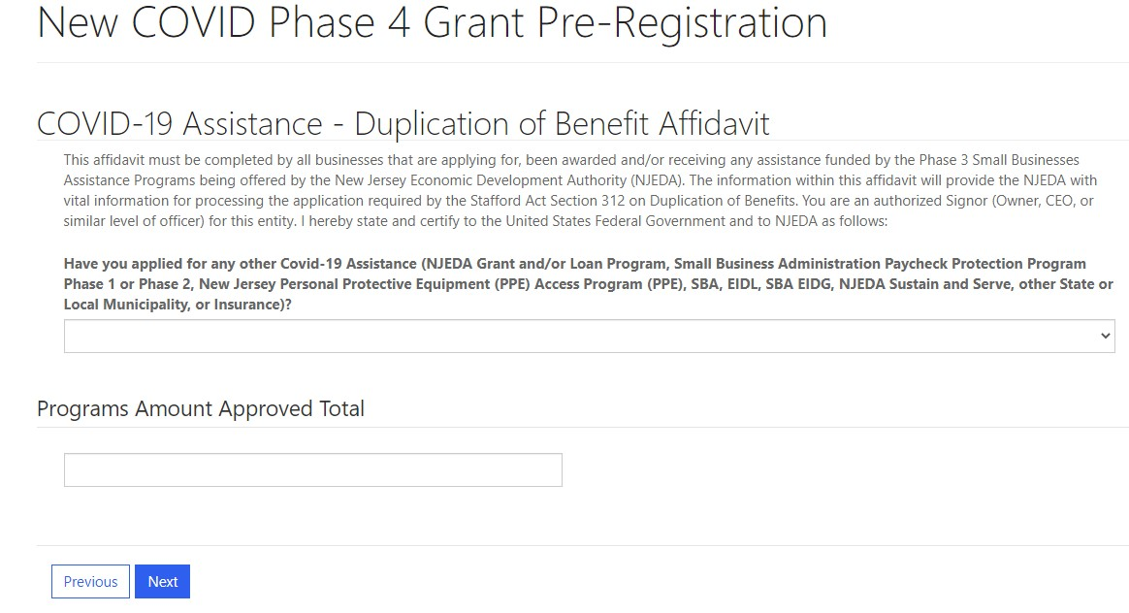
Phase 4 Grant Pre-Registration
Small Business Emergency Assistance Grant

Slide 31
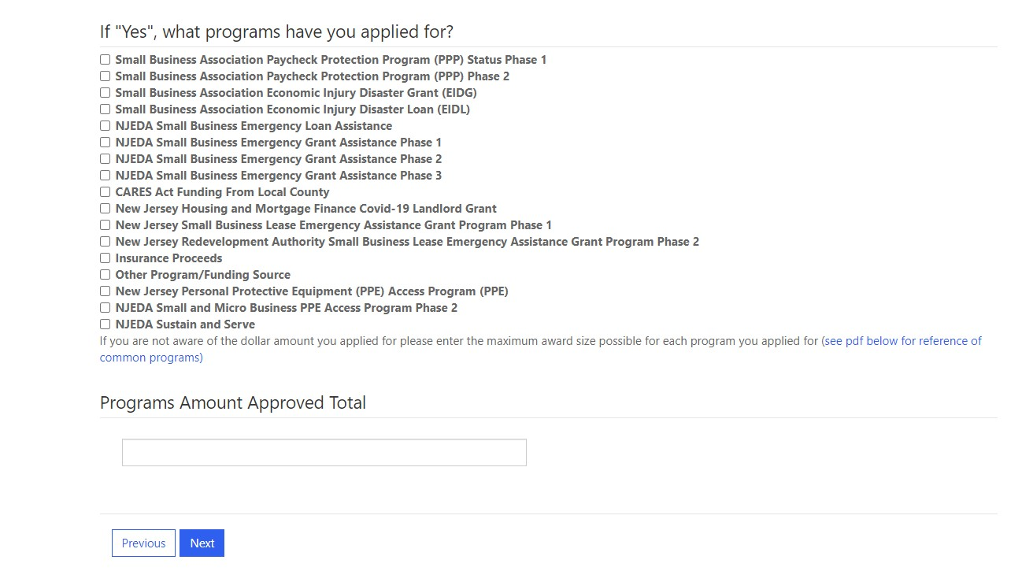
Phase 4 Grant Pre-Registration
Small Business Emergency Assistance Grant

Slide 32
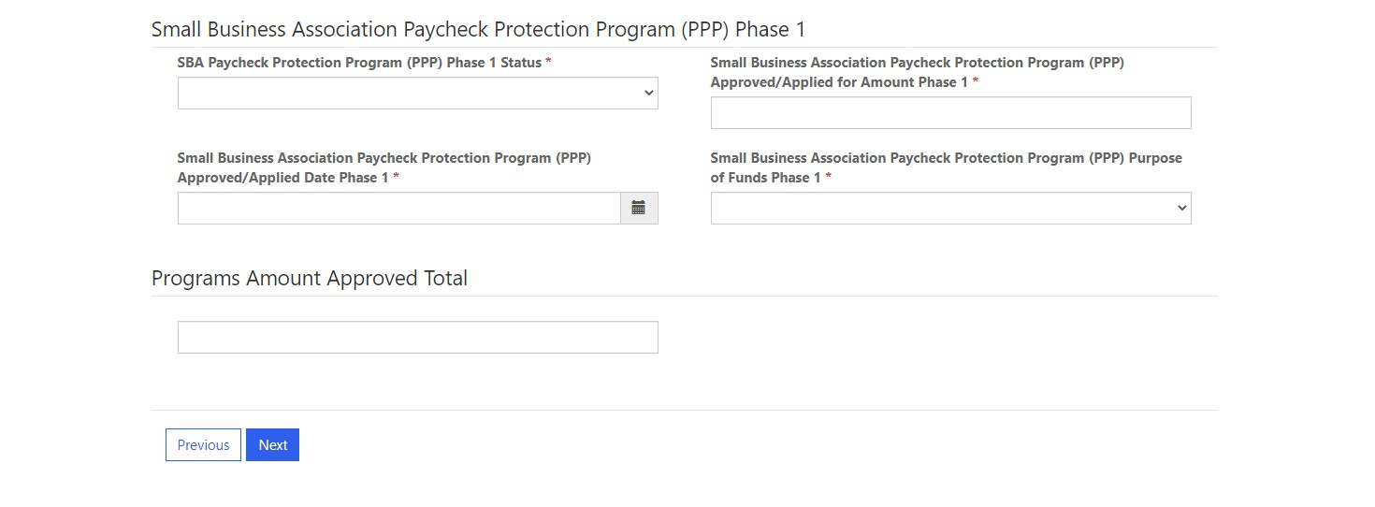
Small Business Emergency Assistance Grant
Phase 4 Grant Pre-Registration
For each item selected, a drop down with additional questions will appear – see below for example:

Slide 33
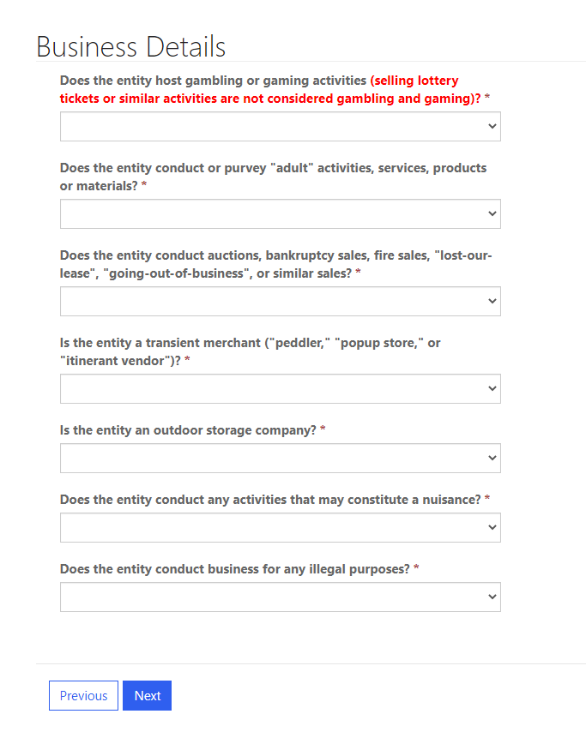
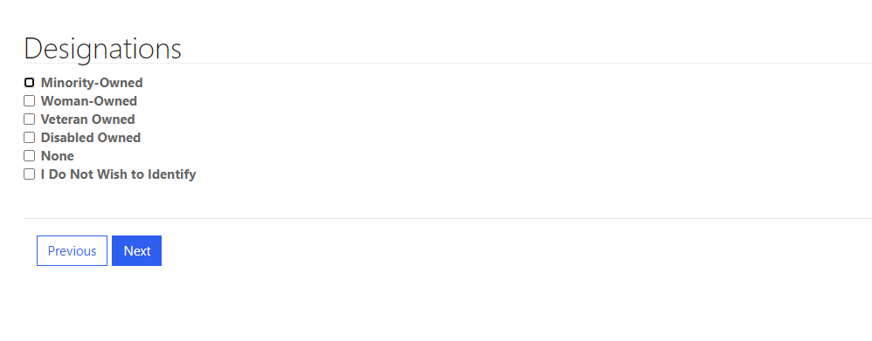
Phase 4 Grant Pre-Registration
Small Business Emergency Assistance Grant

Slide 34
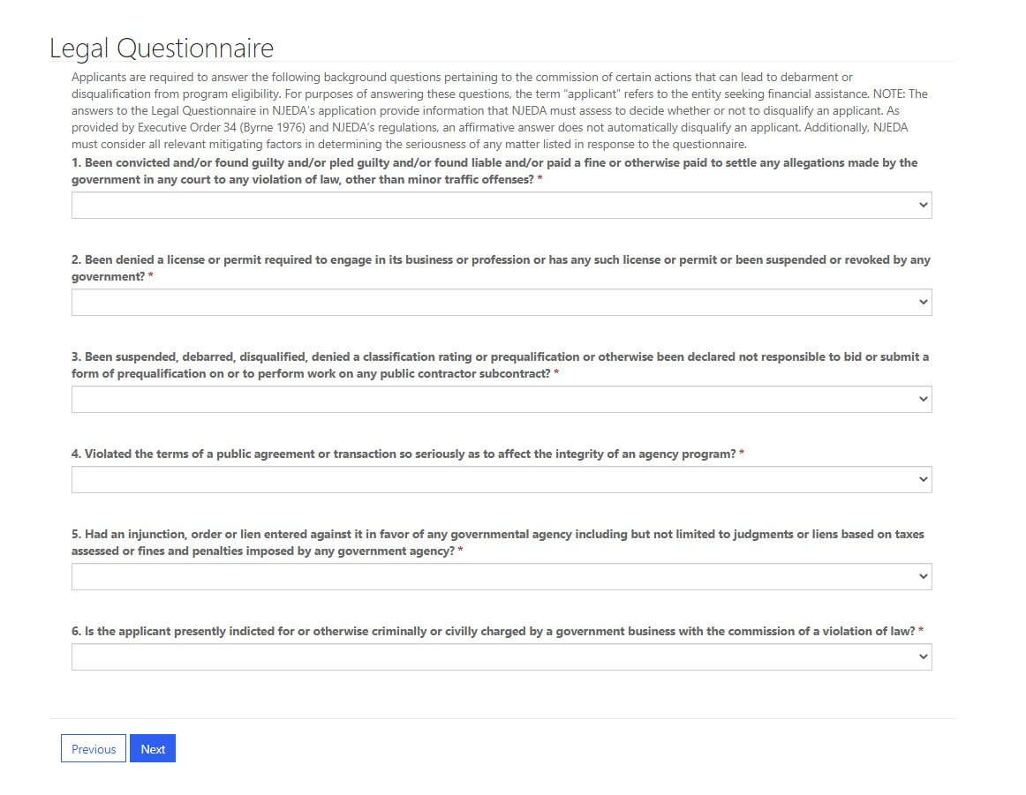
Phase 4 Grant Pre-Registration
Small Business Emergency Assistance Grant

Slide 35
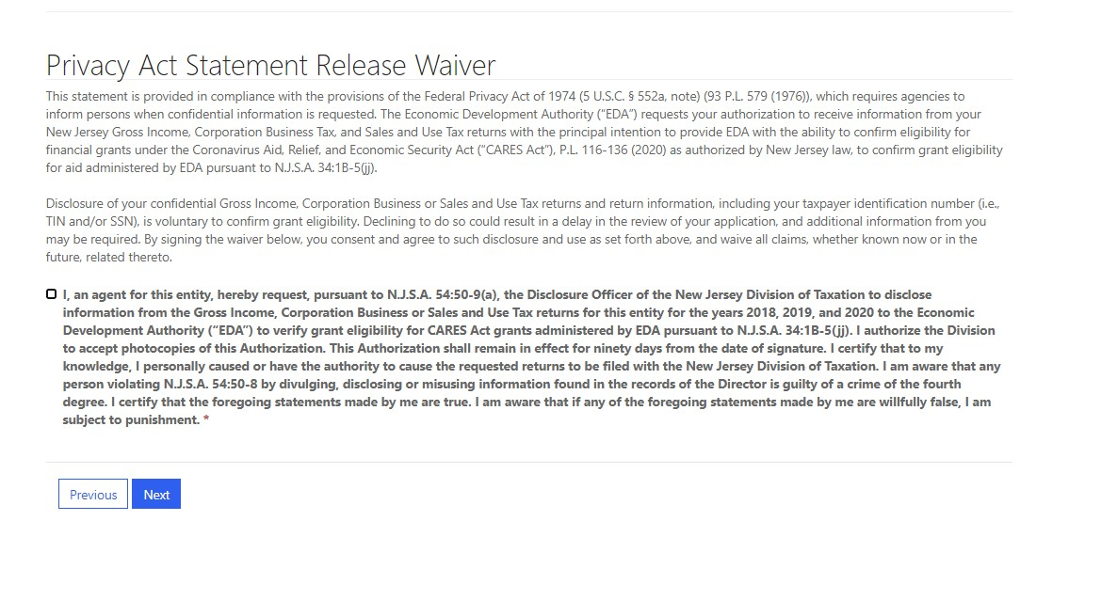
Phase 4 Grant Pre-Registration
Small Business Emergency Assistance Grant

Slide 36
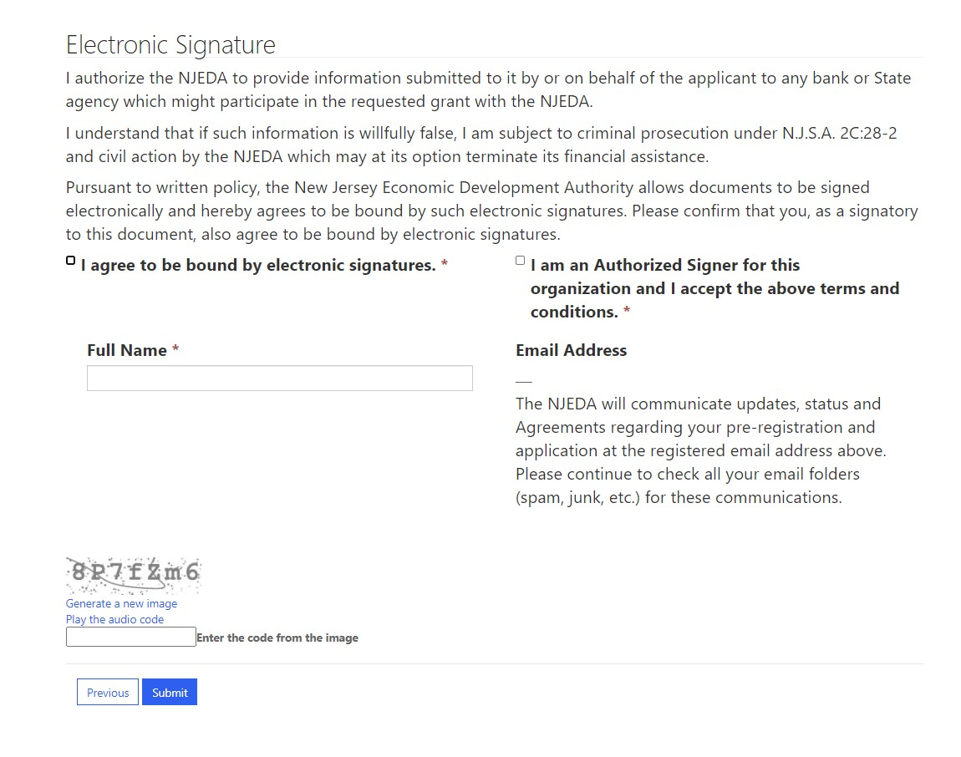
Phase 4 Grant Pre-Registration
Small Business Emergency Assistance Grant

Slide 37
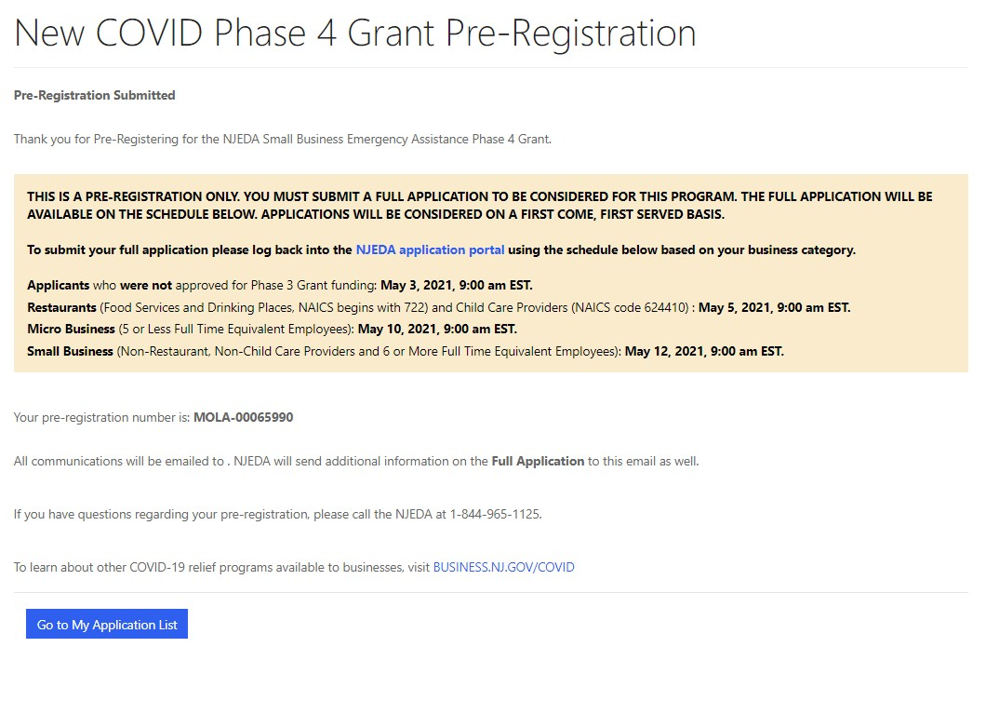
Phase 4 Grant Pre-Registration
Small Business Emergency Assistance Grant

Slide 38
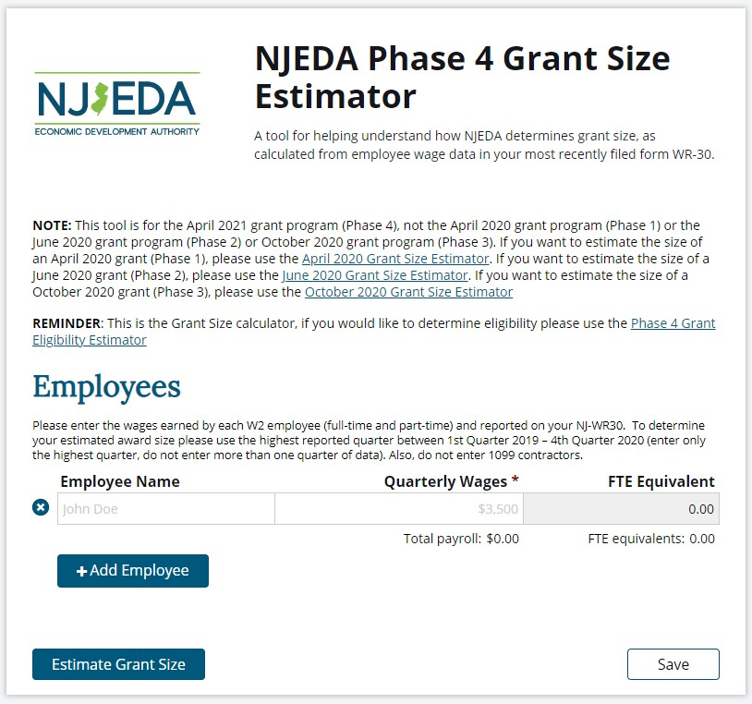
Phase 4 Grant Size Estimator
Small Business Emergency Assistance Grant

Slide 39
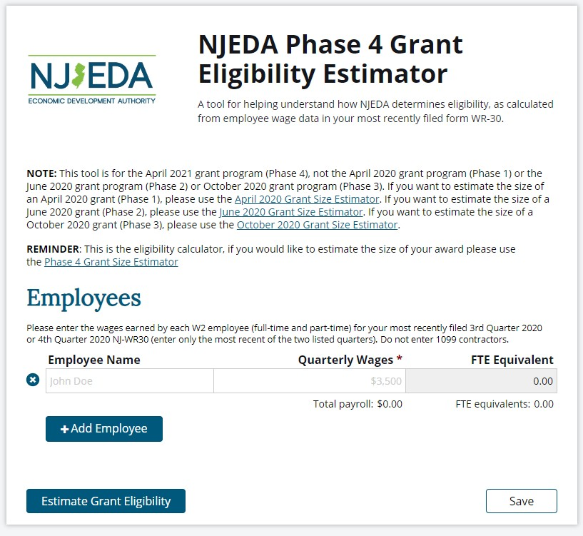
Phase 4 Grant Eligibility Estimator
Small Business Emergency Assistance Grant

Slide 40
Phase 4 Grant Application
Small Business Emergency Assistance Grant
Questions will focus heavily on COVID-19 Impact
Applicants will need to be able to answer the following:
► Were you deemed an essential business based on Executive Order #107?
►If non-profit, what type (501 C-3,4,6 etc.)?
► To what capacity was your business able to re-open?
►What was your Revenue Loss as a result of COVID-19?
►What is your Additional Financial Need as a result of COVID-19 (after other COVID-19 Assistance)?
►What will the Grant Proceeds be used for (if approved)?

Slide 41
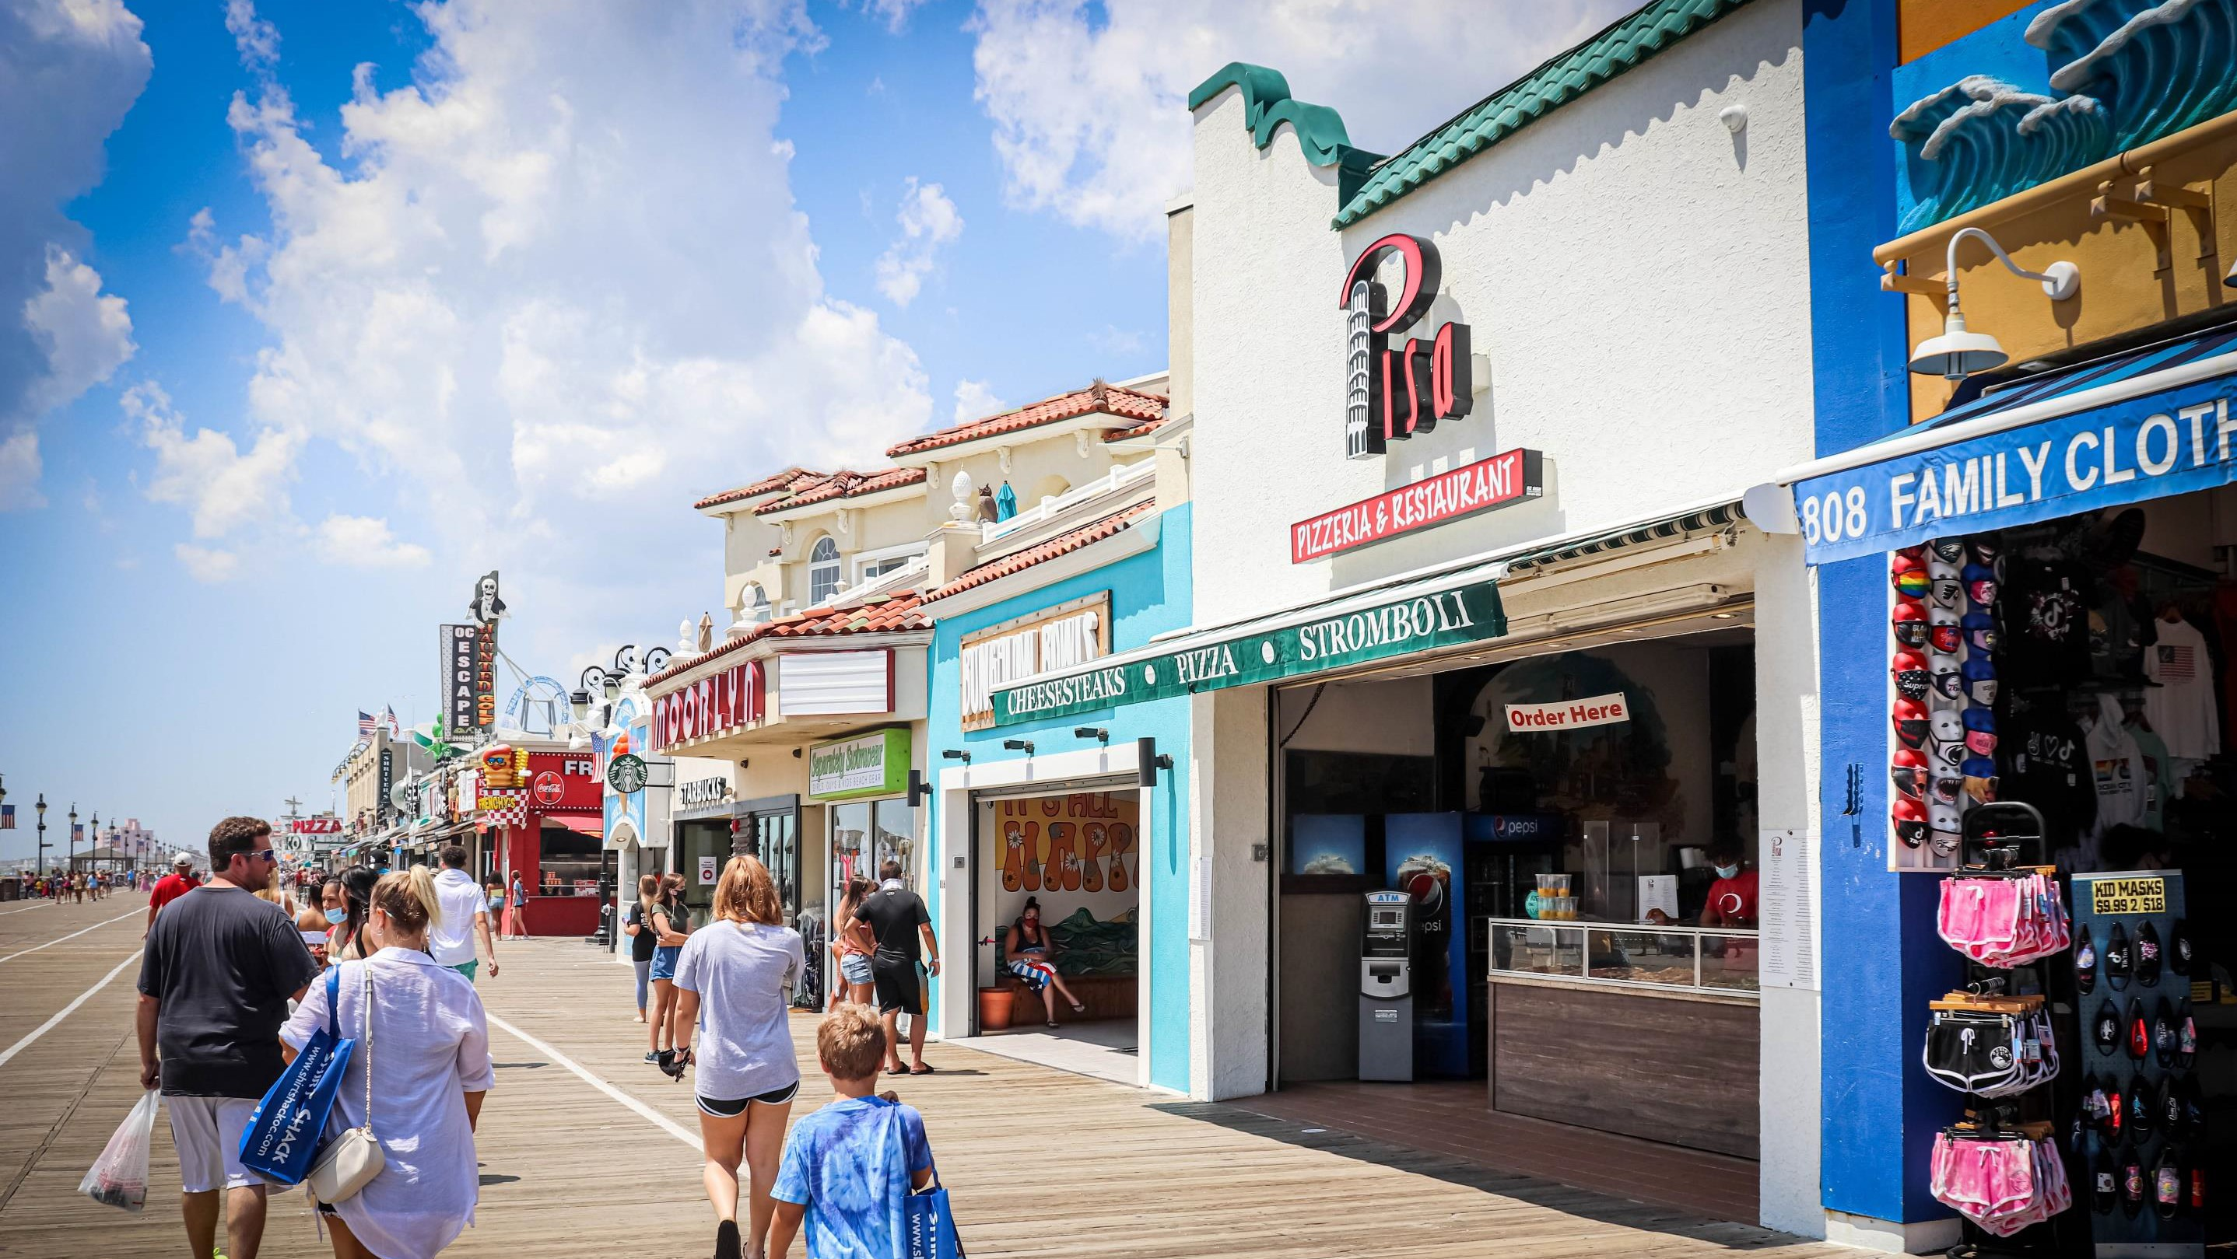









41
Visit NJEDA.com or business.nj.gov/covid
for more information.
@NewJerseyEDA | njeda.com | 844.965.1125
41

