Slide 1
COVID-19 Economic Relief Package
NJEDA initiatives aimed at stabilizing and revitalizing local small businesses, mid-size businesses, and startups or other early-stage companies
June 5, 2020

Slide 2
We have developed our economic stability approach around three core principles
Get funding into the market as soon as possible
Where possible, adjust existing NJEDA programs to address crisis needs
Utilize multiple channels / partners to maximize marketing of programs and minimize processing capacity constraints
Leverage private, federal, and philanthropic capital where possible to scale impact
Provide a suite of compatible offerings to help address varied marketplace needs (e.g., grants, no-cost loans, low-cost loans, loans through intermediaries, technical assistance)

Slide 3
COVID-19 Economic Relief Package
SMALL BUSINESS EMERGENCY ASSISTANCE GRANT PROGRAM (Phase 1 & 2)
SMALL BUSINESS EMERGENCY ASSISTANCE LOAN PROGRAM
PROGRAMS TO MOBILIZE CAPITAL TO MICRO-, SMALL, & MEDIUM-SIZED BUSINESSES
CDFI First Loss Reserve Fund
Emergency Assistance Guarantee
Entrepreneur Support Program
NJ TECHNICAL ASSISTANCE SUPPORT
CREDIT FLEXIBILITY TO SUPPORT BUSINESSES

Slide 4
SMALL BUSINESS EMERGENCY ASSISTANCE GRANT PROGRAM
NJEDA Program Size
$5M (initial wave) Funds Exhausted April 3rd
Operating expense grants of up to $5K to small businesses with 1-10 FTE in highly impacted industries
Additional $5 million from Phase 2 will fund waitlisted Phase 1 applications
Business Eligibility
Industries, as determined by NAICS code:
Retail
Accommodation & Food Service
Arts, Entertainment, & Recreation, Repair & Maintenance; Personal & Laundry Services
(Eligible NAICS codes that start with 44, 45, 71, 72, 811, 812)
Non-profit entities in the above industries are permitted to receive grant funding if they also have the following designations: 501(c)(3), 501(c)(4), and 501(c)(7)
Physical commercial location in NJ
Must be registered to do business in New Jersey and in good standing with Department of Labor
1-10 FTE per Company’s 2019 4th Quarter NJ-WR30 filing with the Department of Labor; visit our grant award estimator to help determine your FTE: https://cv.business.nj.gov
Must fill out and certify simplified debarment legal questionnaire and certify to negative impact of emergency

Slide 5
SMALL BUSINESS EMERGENCY ASSISTANCE GRANT PROGRAM – PHASE 2
Program Size
$45M (Phase 2)
Operating expense grants of up to $10K to small businesses with 1-25 FTE and sole proprietorships
Business Eligibility
Businesses with 25 or fewer FTE per Company’s most recently NJ-WR30 filing with the Department of Labor; visit our grant award estimator to help determine your FTE: https://cv.business.nj.gov
An entity with no WR30 filings will be eligible for a grant amount of $1,000.
Sole proprietorships, 1099 entities
Non-profit entities that have the following designations: 501(c)(3), 501(c)(4), and 501(c)(7)
Has a material financial need that cannot be overcome without the grant of emergency relief funds at this time
Entity must be registered to do business in New Jersey at the time of application and in operation as of February 15, 2020
Department of Labor good standing
Must fill out and certify simplified debarment legal questionnaire
Previous Applicants:
Businesses with 5 or fewer FTE that were approved under Phase 1 are NOT eligible for Phase 2 as they will have reached their maximum funding.

Slide 6
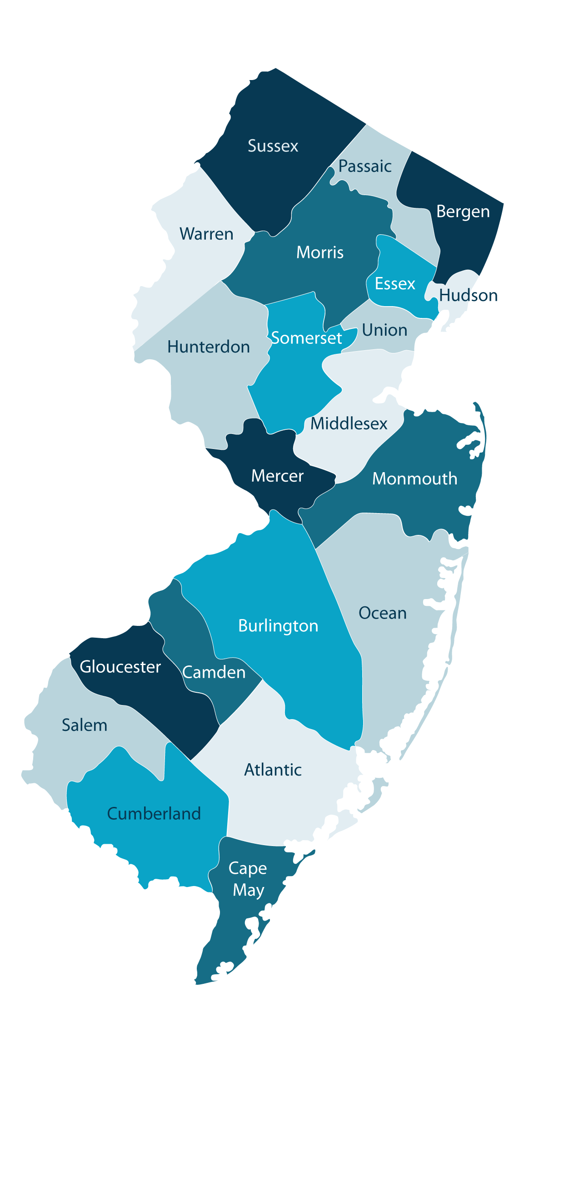
ENSURING EQUITY, INCREASING ACCESSIBLITY
$15 million of Phase 2 funding will be reserved for eligible businesses in Eligible Opportunity Zones Census Tracts (OZs)
Every county has at least one eligible Opportunity Zone census tract
Link to COVID business portal for OZ map tool
Language access services will be available to non-English speaking applicants:
Application and cv.business.nj.gov portal available in Spanish
NJEDA has contracted for interpretation services to support speakers of nine additional languages – Arabic, Chinese (Mandarin and Cantonese), Gujarati, Hindi, Italian, Korean, Polish, Portuguese, and Tagalog. Translated versions of the application itself will be available in advance of opening.
In advance of the application launch, applicants can contact languagehelp@njeda.com to receive a call within one business day from a representative who can communicate with them in their primary language

Slide 7
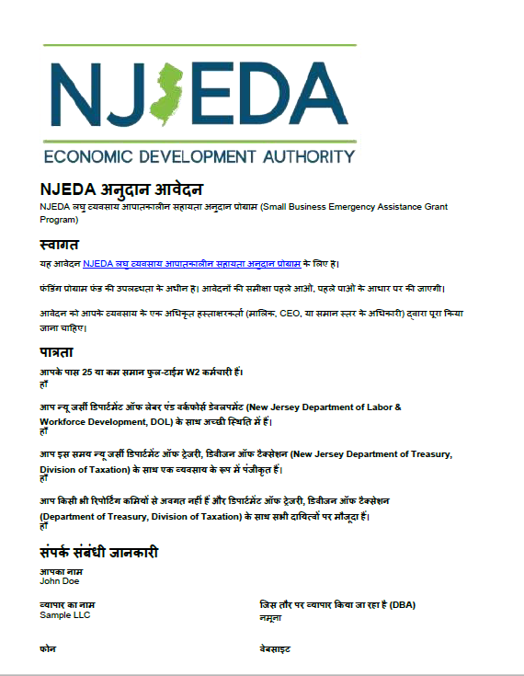
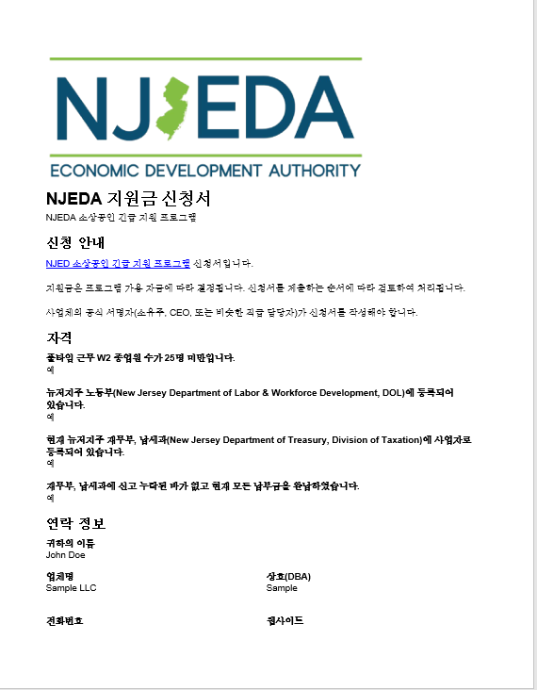
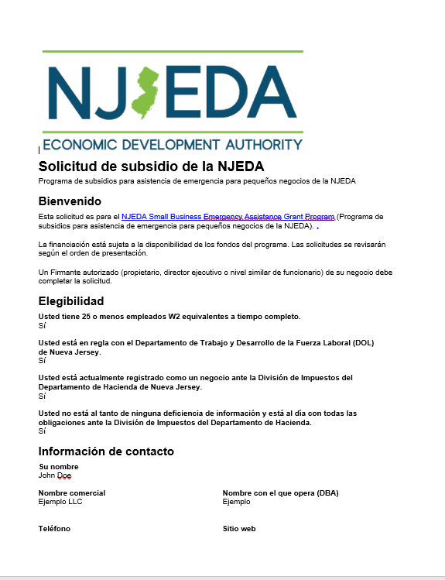
ENSURING EQUITY, INCREASING ACCESSIBLITY

Slide 9
REQUIRED INFORMATION
Be Prepared:
View the sample application on the Covid-19 Business Portal: https://cv.business.nj.gov
Have your contact information and primary business address readily available
If you have received other Government assistance (NJEDA, PPP, EIDL, EIDG, etc), be prepared to provide information regarding status, uses and amounts.
Business’s full legal name - the one used when your registered with the State of NJ
Entity type (Sole Prop, LLC, C-Corp, S-Corp, etc.)
Year established
Tax ID Number
Headcount as of March 31, 2020 (W2 Full-time, W2 Part-time, 1099s)
North American Industry Classification System (NAICS Code)
Revenues for March to May of 2019 and March to May of 2020
Know Your:
Application window opens on Tuesday, June 9, 2020, at 9:00 am

Slide 10
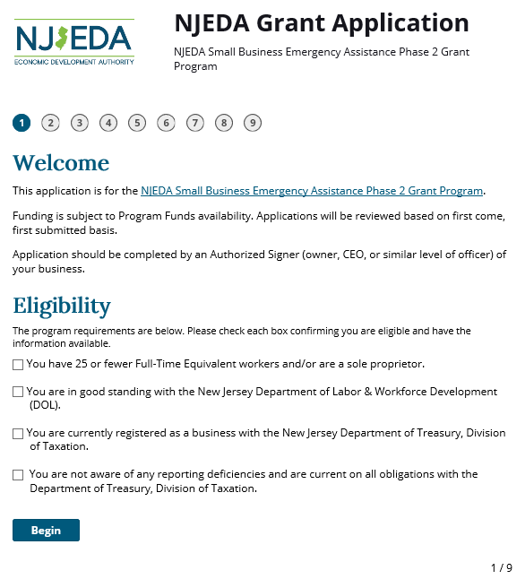
Grant Application Screen Shots: Welcome and Eligibility
Application window opens on:
Tuesday, June 9th 09:00am ET
Application window closes on:
To be determined based on funding availability
Application will be available at:
https://cv.business.nj.gov

Slide 11
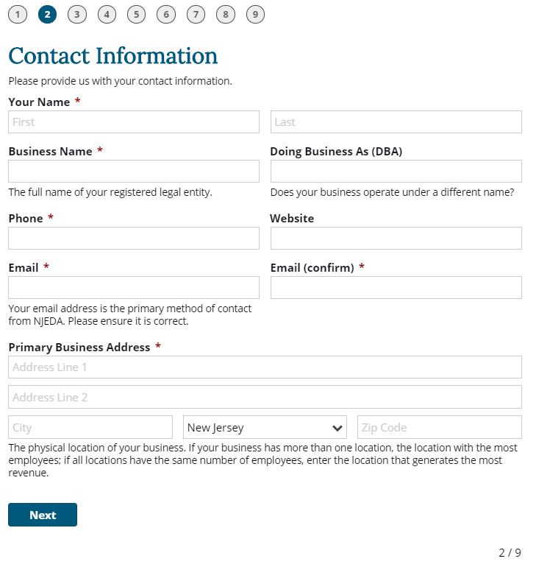
Grant Application Screen Shots: Contact information for your business

Slide 12
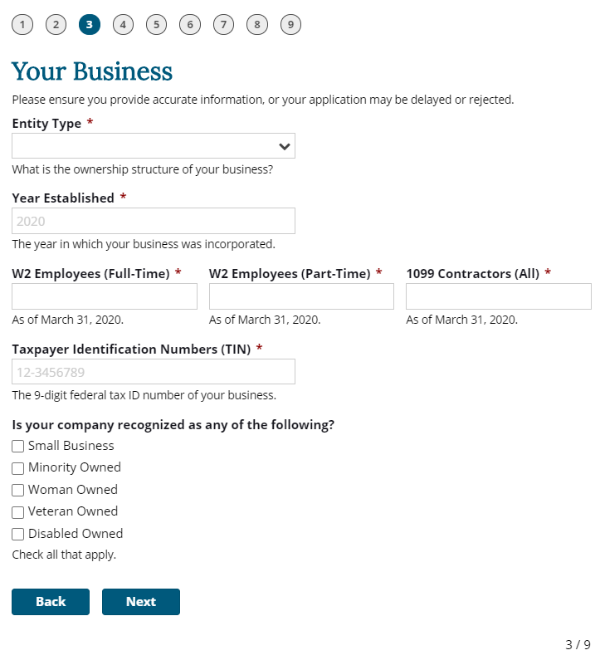
Grant Application Screen Shots: Information about your industry (1/2)
Entity types include:
Sole Proprietorship
Limited Liability Corporation (LLC)
Single-Member LLC (SMLLC)
Partnership
C-Corporation
S-Corporation
501(c)(3) nonprofit
501(c)(4) nonprofit
501(c)(7) nonprofit
Other (estate, municipality, etc.)
Check if you self-identify as one of these business types

Slide 13
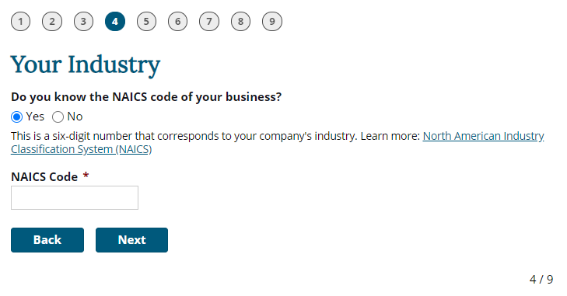
Grant Application Screen Shots: Information about your industry (1 /2)

Slide 14
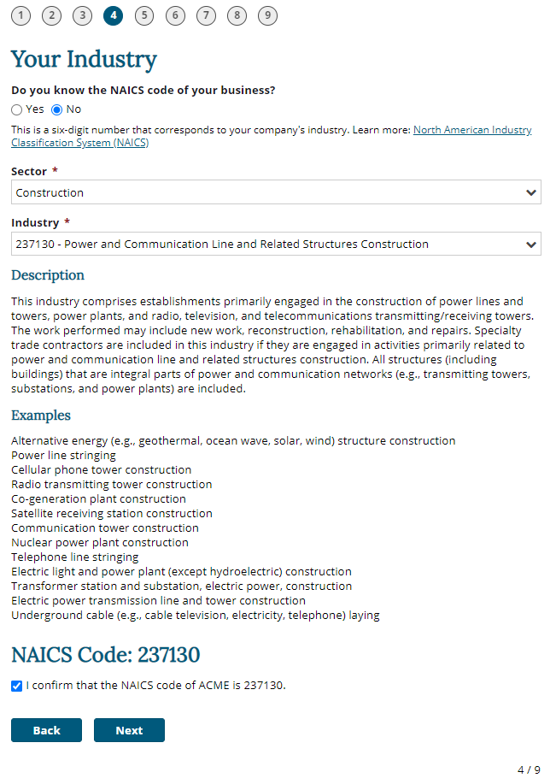
Grant Application Screen Shots: Information about your industry (2/2)
Pre-populated options
Pre-populated options
Automatically populated description for the organization to check
Need to confirm

Slide 15
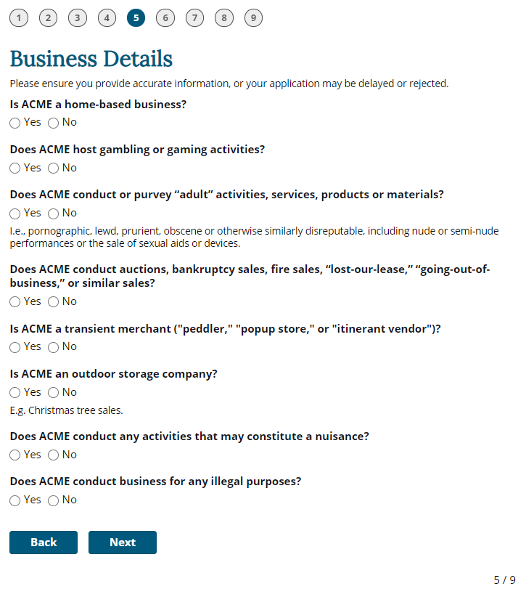
Grant Application Screen Shots: Business Details
Home-based businesses are allowed in Round 2 of the program

Slide 16
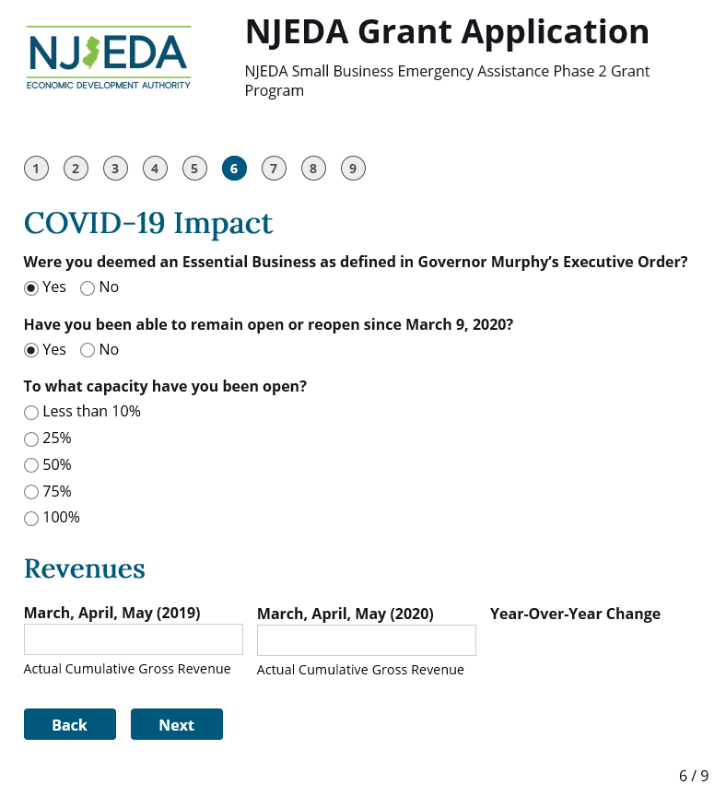
Grant Application Screen Shots: COVID-19 Impact
If your business remained open, was it at normal levels or less
Dollar value impact over the last three months on your business as a result of Covid-19

Slide 17
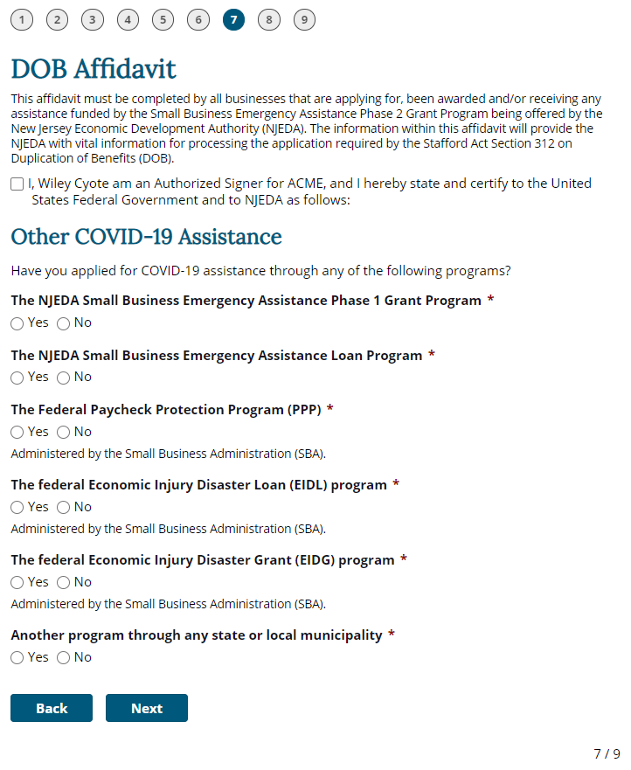
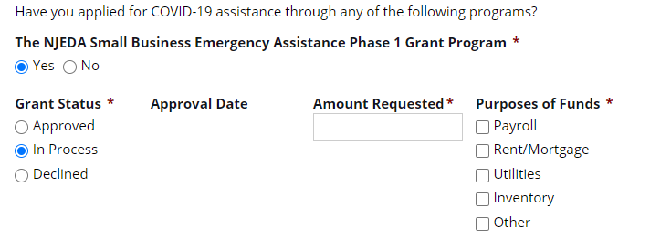
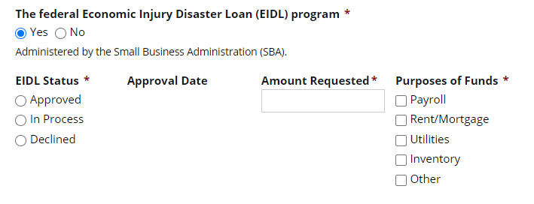
Grant Application Screen Shots: Duplication of Benefit (DOB) Affidavit
Examples if yes is selected:

Slide 18
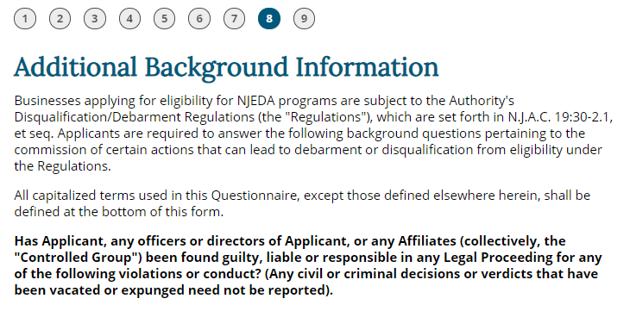
Grant Application Screen Shots: Additional Background and Certifications (1/2)

Slide 19
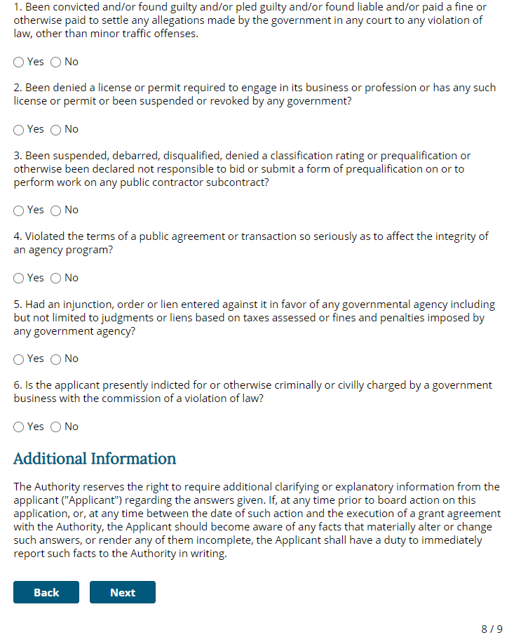
Grant Application Screen Shots: Additional Background Information
Question about prior convictions
Questions about license or permit denials or revocations
Question about public debarment
Question about breaking the terms of an agreement with a public agency
Question about any injunction orders in favor of a government agency
Question about ongoing criminal or civil proceedings
Examples if “Yes” is selected:

Slide 20
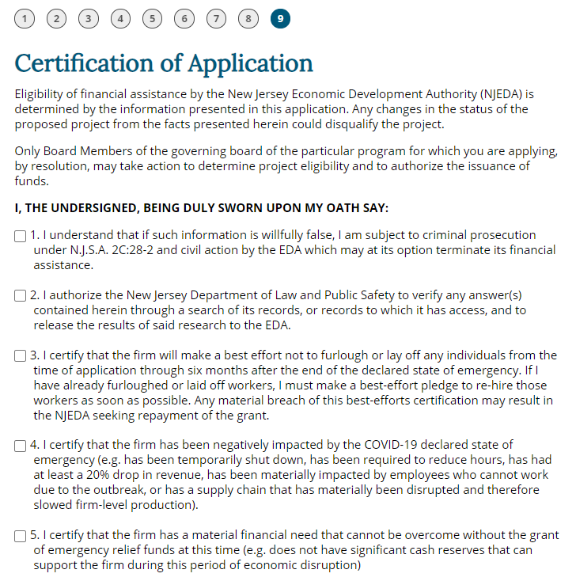
Grant Application Screen Shots: Certifications (1/3)
False statements can be prosecuted
Dept. of Law can verify my answers
Best effort not to lay off employees and rehire those that have already been let go
I have been negative impacted by COVID-19
This grant is needed by my business

Slide 21
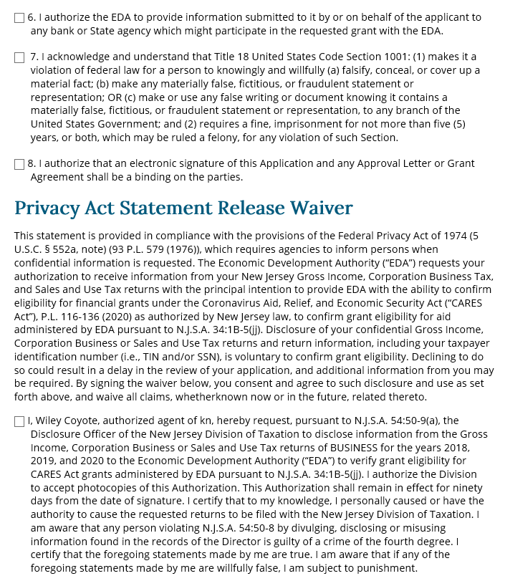
Grant Application Screen Shots: Certifications (2/3)
NJEDA can share information with specific parties to execute this grant
False statements can be prosecuted under federal law
I am signing this electronically
Taxation can share information with the NJEDA

Slide 22
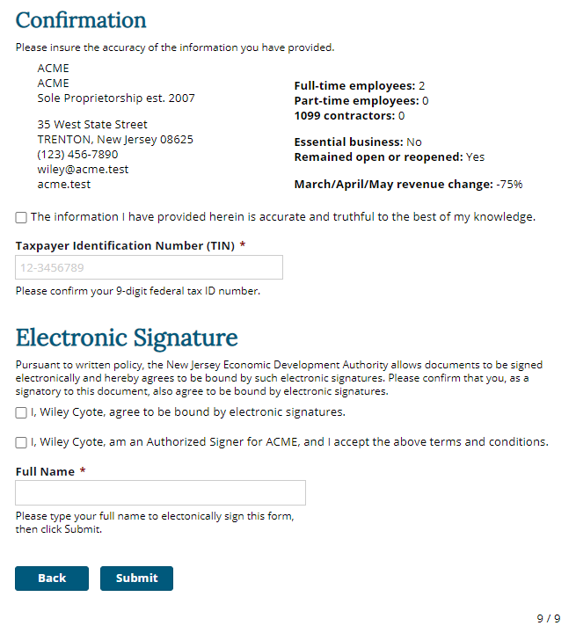
Grant Application Screen Shots: Certifications (3/3)
Populated based on responses previously inputted into the application
Confirm your Tax ID Number
Confirm your electronic signature

Slide 23
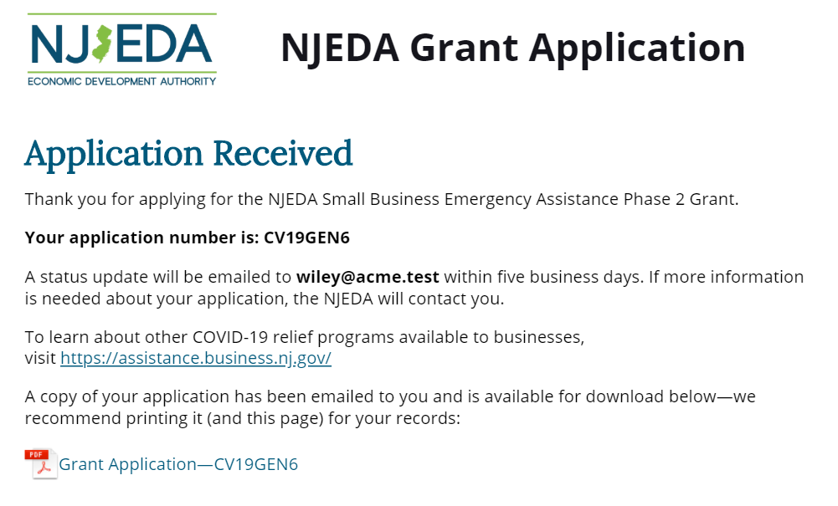
Grant Application Screen Shots: Confirmation

Slide 24
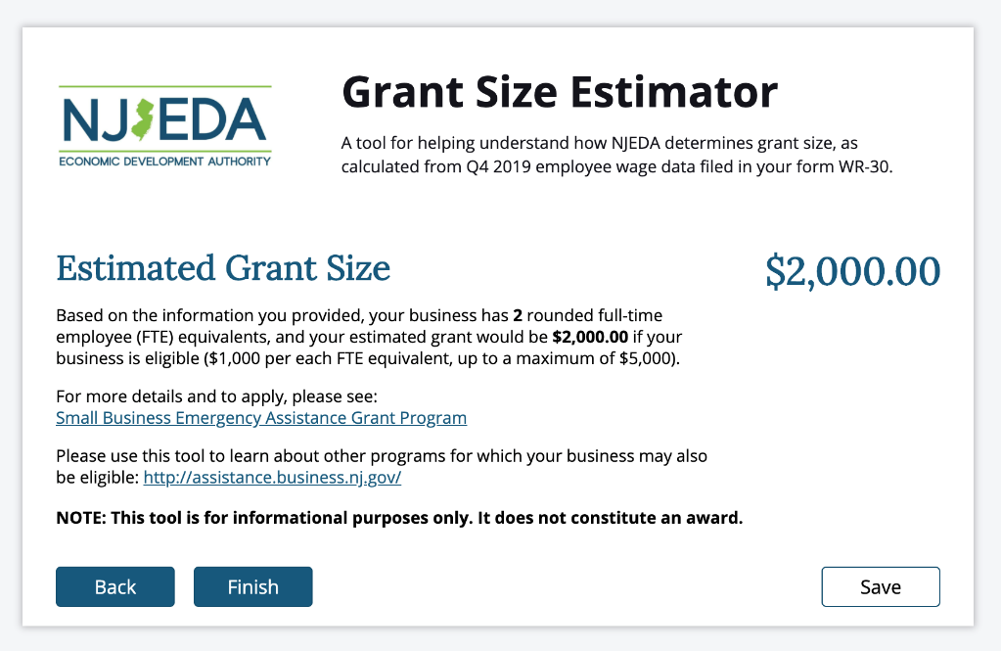
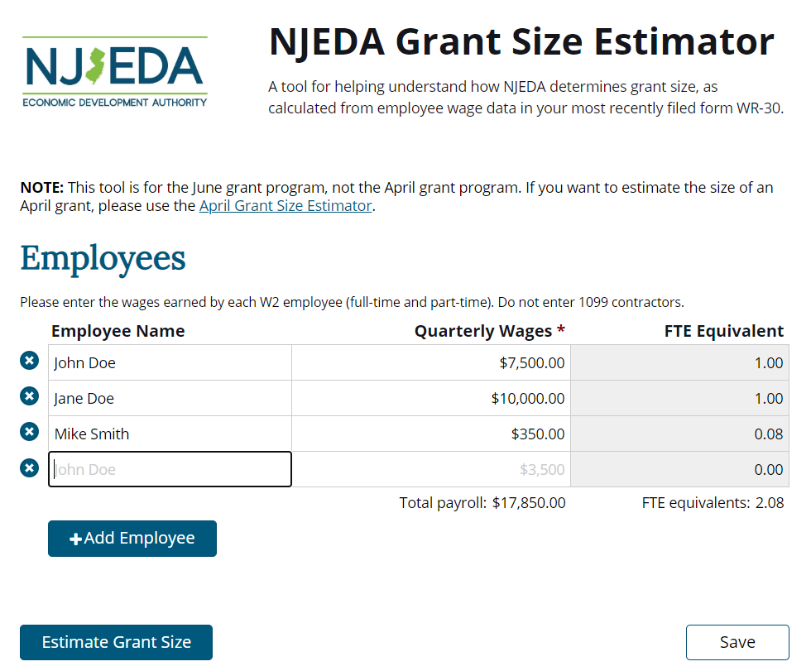
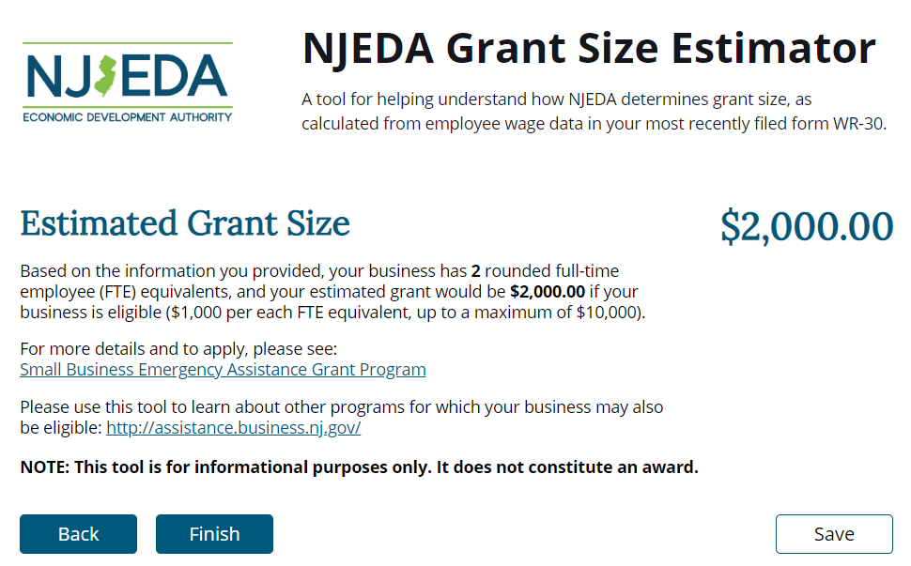
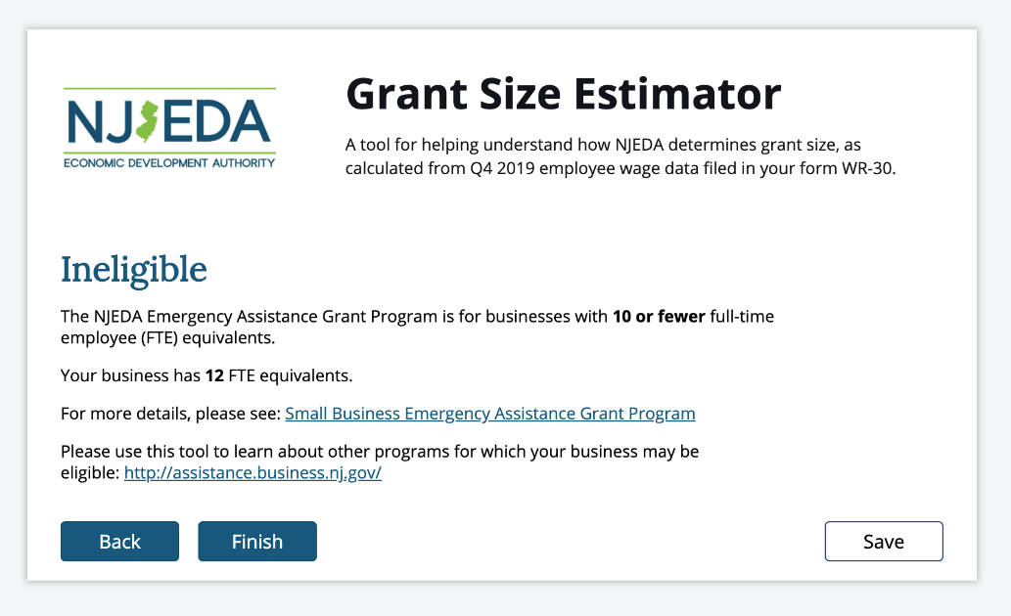
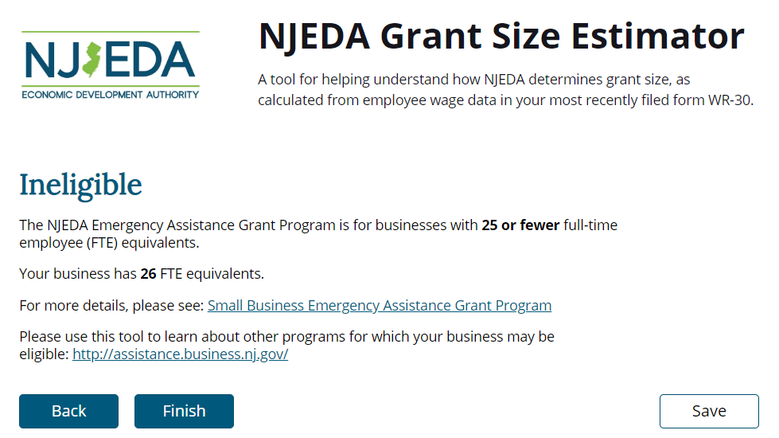
Grant Award Size Estimate Calculator Screen Shot
Available at: https://cv.business.nj.gov

Slide 25
PROGRAMS TO MOBILIZE CAPITAL TO MICRO-, SMALL, & MEDIUM-SIZED BUSINESSES
CDFI First Loss Reserve Fund $10M capital reserve fund for first-loss position, up to 50%, on CDFI loans that provide low/no-interest loans to micro and small businesses
NJEDA Program Size
$10M (initial wave)
Eligibility
Federally-certified, NJ-based CDFI
Have the operational and financial capacity to use the guarantee effectively
Have significant experience working with underserved business segments and in communities underserved by other banks
Must fill out and certify simplified debarment legal questionnaire
CDFI Loans that are guaranteed must:
Be to an impacted business
Be focused on working capital
Not exceed $75,000
Have an interest rate of 3.75% or less
Not exceed a term of five years
Provide flexible loan structures

Slide 26
PROGRAMS TO MOBILIZE CAPITAL TO MICRO-, SMALL, & MEDIUM-SIZED BUSINESSES
NJEDA-Approved COVID-19 CDFI Partners:

Slide 27
ENCOURAGING INVESTMENT IN EMERGING COMPANIES
NJ Entrepreneur Support Program Provide 80% loan guarantees for working capital loans to entrepreneurs
NJEDA Program Size
$5M (initial wave) Launched April 22nd
Eligibility
Must be NJ-based company (registered to do business, C-suite in the State)
Under $5M in revenue; under 25 people
Investors have already provided funding in the form of a convertible note, safe or equity interest.
Investor does not need to be NJ-based
Align with the Governor’s Economic Plan
Must fill out and certify simplified debarment legal questionnaire
Tax Clearance; Department of Labor good standing
Minimum of 50% of employees in NJ

Slide 28
Loans to Support Small NJ Businesses
Micro Business Loan
Small Business Fund
Direct Loan
Up to $50,000 for working capital or equipment Low interest/flexible terms | Small businesses: Up to $500,000 Not-for-profits: Up to $500,000 with 1.0X historical debt service coverage | Up to $2 million for fixed assets Up to $750,000 for working capital
ELIGIBILITY For-profit registered New Jersey business Annual revenue less than $1.5 million 10 or less full-time employees Start-Ups eligible (see application for details) | ELIGIBILITY Must be in operation for at least one full year Not-for-profits for at least three full years Annual revenue less than $3 million | ELIGIBILITY Create/Retain one full-time job for every $65,000 within two years
Please visit NJEDA.COM/MICROBUSINESSLOAN for more information. | Please visit NJEDA.COM/SMALLBUSINESSFUND for more information. | Please visit WWW.NJEDA.COM/DIRECTLOANS for more information.
Additional eligibility requirements and standard underwriting practices will apply. Visit NJEDA.com for more information.

Slide 29
New Jersey Launches PPE Supplier Registry to Facilitate Access to COVID-19 Protective Gear
Connect suppliers of personal protective equipment (PPE) that can prevent the spread of COVID-19 with potential buyers.
Wholesale vendors with PPE inventory such as surgical or other protective masks, hospital gowns, hand sanitizer, or COVID-19 test kits can submit details on supplies they have available and hospitals, medical organizations, and private businesses can purchase.
The registry is a joint effort by the Office of Governor Murphy, the New Jersey Department of the Treasury, the Office of Emergency Management (OEM), the Office of Innovation, and the NJEDA’s Office of Economic Transformation.
The database is updated several times per week, and is easily filtered and sorted by product type, size, payment terms, location of supplier, and several other criteria.
Suppliers who wish to be included in the Registry should fill out the PPE Supplier Registry intake form.
MORE THAN 1,000 REGISTERED BUSINESSES
PPE Wholesale Supplier Registry Public Listing
PROVIDING MORE THAN 2,500 PRODUCTS
The information about the vendors and products in this database is provided by the vendors and compiled by the State for the express purpose of assisting private businesses and organizations in New Jersey access potential suppliers for PPE and other COVID-related goods and services. Any other use of this information is prohibited. All parties are strongly advised to exercise due diligence when selecting vendors and are responsible for ensuring the quality and regulatory compliance of all good/services purchased. Please ensure you are following your organization’s policies and practices concerning vendor capability and responsibility to ensure that you are making a safe purchase.

Slide 30
Bringing together leaders from diverse industry groups and community organizations throughout New Jersey to advise state leadership on economic matters impacted by COVID-19.
SUBCOMMITTEES
Tim Sullivan Chief Executive Officer Economic Development Authority Co-Chair
Zakiya Smith Ellis Secretary of Higher Education State of New Jersey Co-Chair
Jose Lozano President and CEO ChooseNJ Co-Chair
Transportation & Infrastructure
Manufacturing & Supply Chain
Main Street
Government
Professional Services
Social Services and Faith
Tourism & Entertainment
Facilities and Construction
Health Care

Slide 31
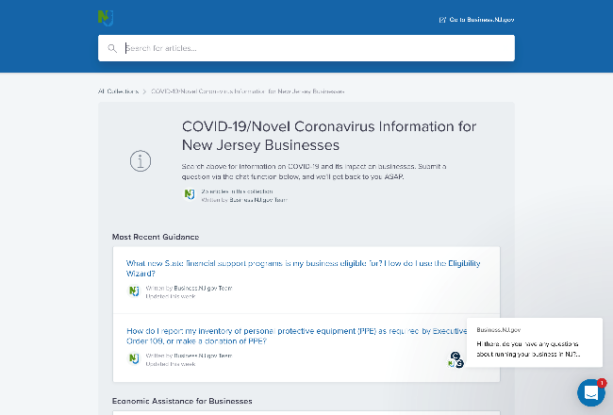
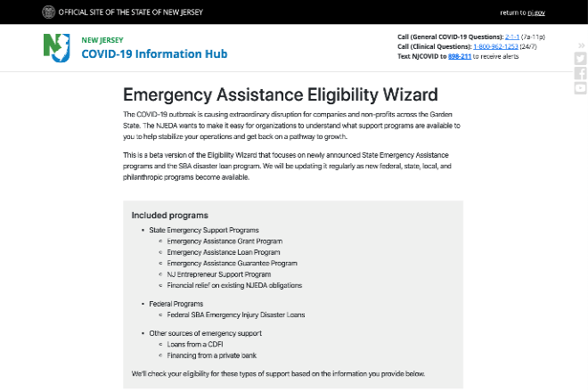
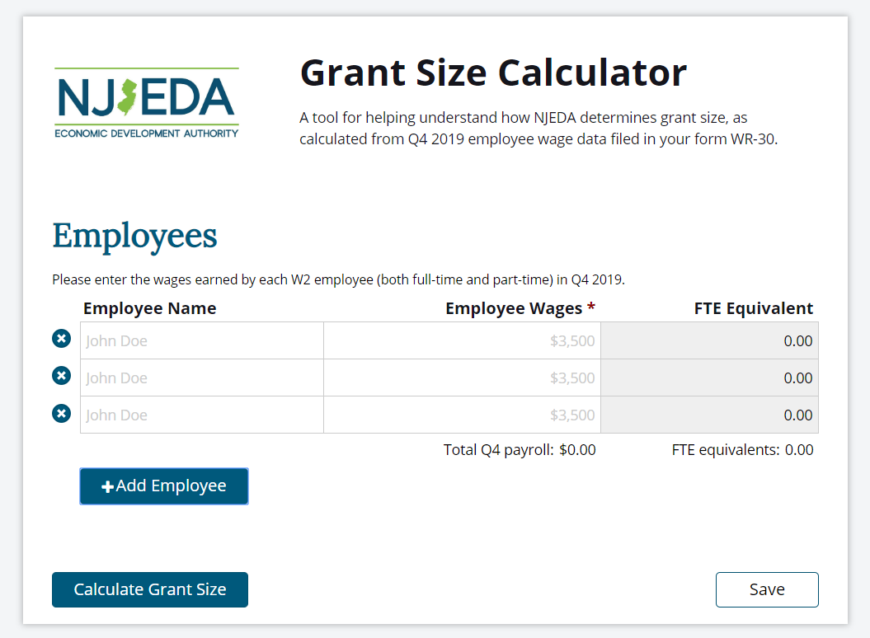
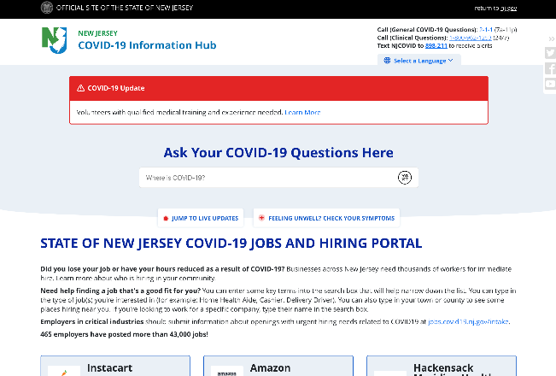
Additional Resources
NEW JERSEY COVID-19 BUSINESS INFORMATION HUB
EMERGENCY ASSISTANCE ELIGIBILITY WIZARD
GRANT AWARD SIZE ESTIMATE CALCULATOR
NEW JERSEY COVID-19
JOBS AND HIRING PORTAL
Get an early estimate of your potential grant award size based on information you submitted on your Q4 2019 NJ WR-30
See what support programs are available to you to help stabilize your operations and get back on a pathway to growth.
Businesses across New Jersey need thousands of workers for immediate hire. Learn more about who is hiring in your community.
Search for information on COVID-19 and its impact on businesses.
CV.BUSINESS.NJ.GOV
CV.BUSINESS.NJ.GOV
CV.BUSINESS.NJ.GOV
JOBS.COVID19.NJ.GOV

